Slide 1
Terminology
Bill Bennett

Slide 2
TracCloud Terminology
Understanding terminology is important in any professional setting, especially when you are referring to different parts of the TracCloud system.
Getting familiar with the terminology allows you to:
Aid Redrock support, as it will help you get the quickest response and solution.
Gain a deeper understanding of how the TracCloud system works.
Enable seamless communication between you and your staff when using TracCloud.

Slide 3
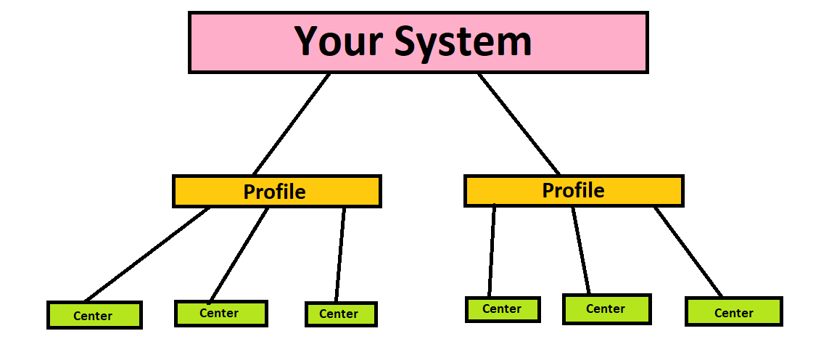
TracCloud License
A License is used for a production or test system. The purchase of a license comes with a custom URL configuration and one profile.
Profiles are an additional layer of configuration where scheduling rules, reasons, and kiosks can be managed on a per-profile basis. A system can have multiple profiles, each with their own configurations.
Centers represent a physical or remote location, this acts as the location field for your visit and appointment data. Centers are linked to a per-profile basis.
License

Slide 4
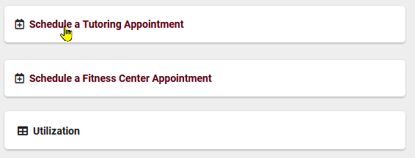
Navigating your trac system
Dashboard
Widget
Hamburger Icon
Accessible features on the Dashboard
Used in all listings, contains all listing options
Homepage for your system
Listing
Navigation Search
List of related records
Used to search in every listing, right clicking provides additional options for your search

Slide 5
accounts
Staff accounts can have access to schedule, visit, and appointment data. The data seen by a staff account can be configured in their group settings.
Profile Admins are users with more access to the system than a staff account, and will be able to adjust profile and group settings. These settings include adjusting centers, email templates, and reasons.
A SysAdmin is a user with full access to the system, this includes all user data, Profile settings, and Global settings. Systems usually have a couple of these users due to the amount of global changes that can be made by these users.
Check out my presentation on Staff for more information on these accounts!

Slide 6
More accounts
Students are the client searching for availabilities and booking appointments.
Faculty are the instructors for one or multiple courses, and are linked to student registrations/enrollments.
Staff Consultants appear on the schedule and interact with your students; they can have access to create their own availability slots/visits. Examples of users that would need staff accounts include: tutors, consultants, advisors, coaches, etc.

Slide 7
Groups
Groups are assigned to different users and are the determining factor for what data each user has access to.
Groups determine center access, student data access, schedule access, resources, and many other aspects of the system.
The system comes with a student, SysAdmin, and faculty group by default. Staff groups are created throughout setup training.

Slide 8
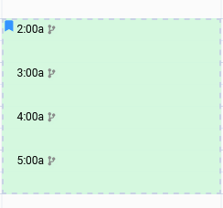
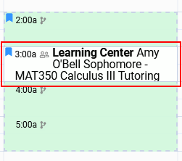
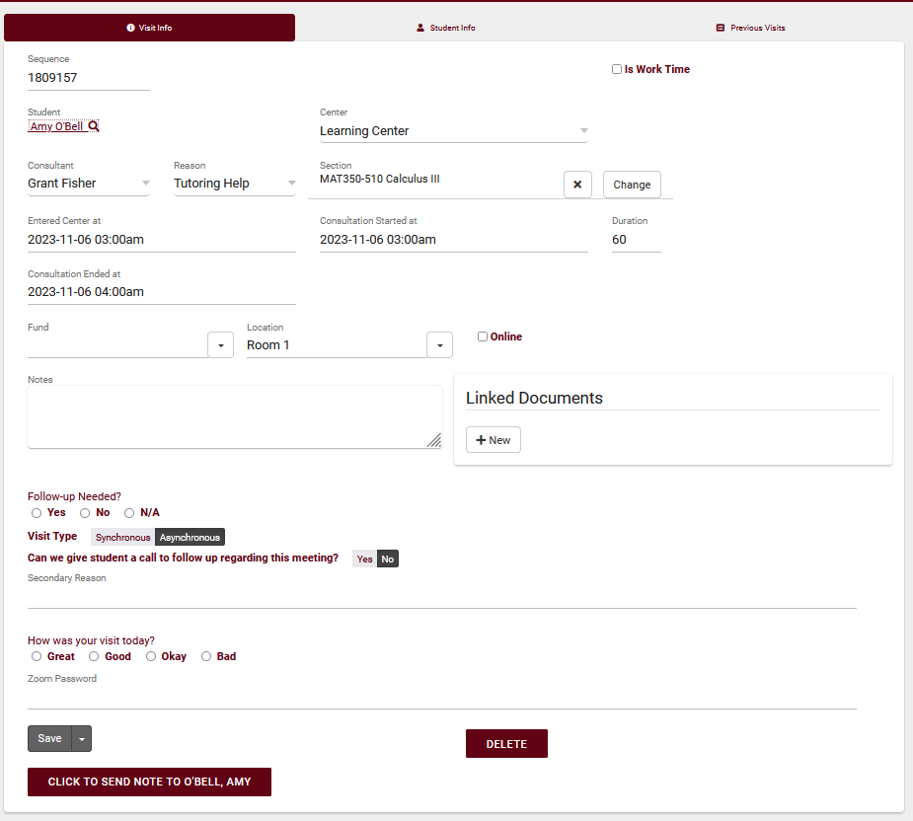
Attendance
TracCloud has 3 types of records; these being availabilities, appointments, and visits. The scheduling process uses these 3 records as shown below:
Availability
Appointment
Visit
Indicates that a consultant is available for their services, and allows for students to book allotted time
Reserved time for a student(s); this record holds time, location, subject, consultant, and reason data
If the student attends the appointment, then a visit record will be created. This record holds section, notes, time, and other data

Slide 9
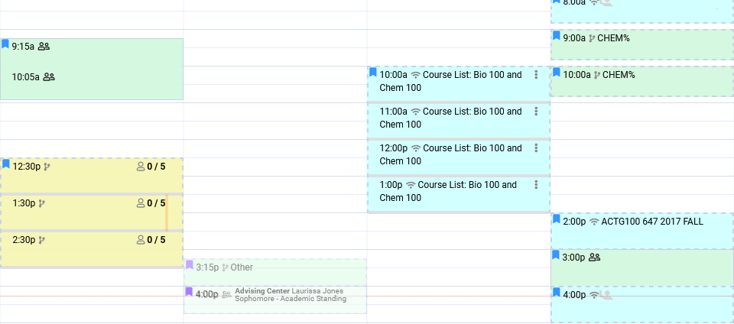
Availabilities
Availabilities in TracCloud are time slots that let students know when staff are available for consulting services.
and Faculty depending on their group permissions.
There are 4 types of availability: One on one, Group, drop in, and Asynchronous
All availabilities can be seen by Students, Staff,
For more information on the schedule, check out Luis’s “Scheduling” session!

Slide 10
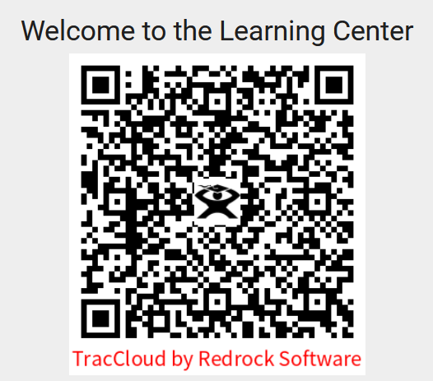
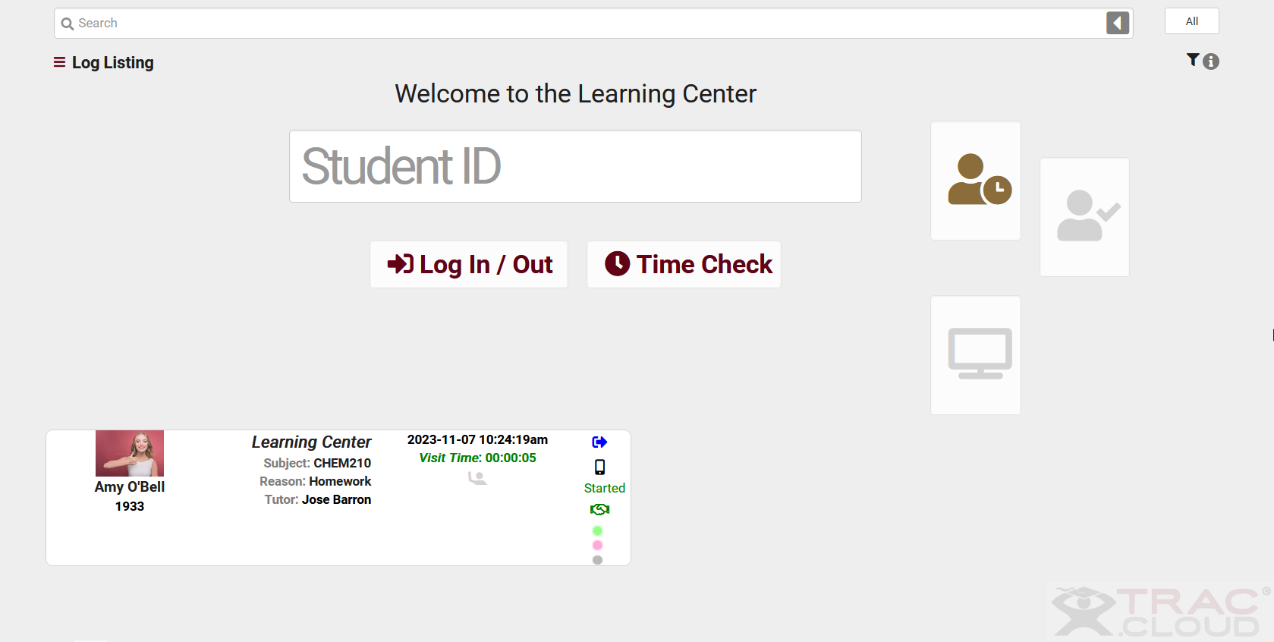
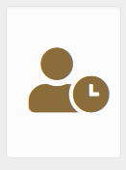
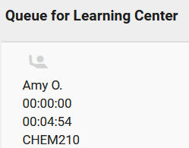
Visits
Kiosk
Log listing
Work Visit
Visit Queue List
Visit records can be created/managed by using the below tools in your TracCloud system:
Student facing screen, used to log in and out of a center
Staff facing, this menu shows a list of students who are currently logged in for a visit
Staff can also track their work visits, this information is used for hours worked/payroll
Student facing screen, used to display students who are waiting to be seen
For more information on Visits, check out Iliana’s “Visits” session!

Slide 11
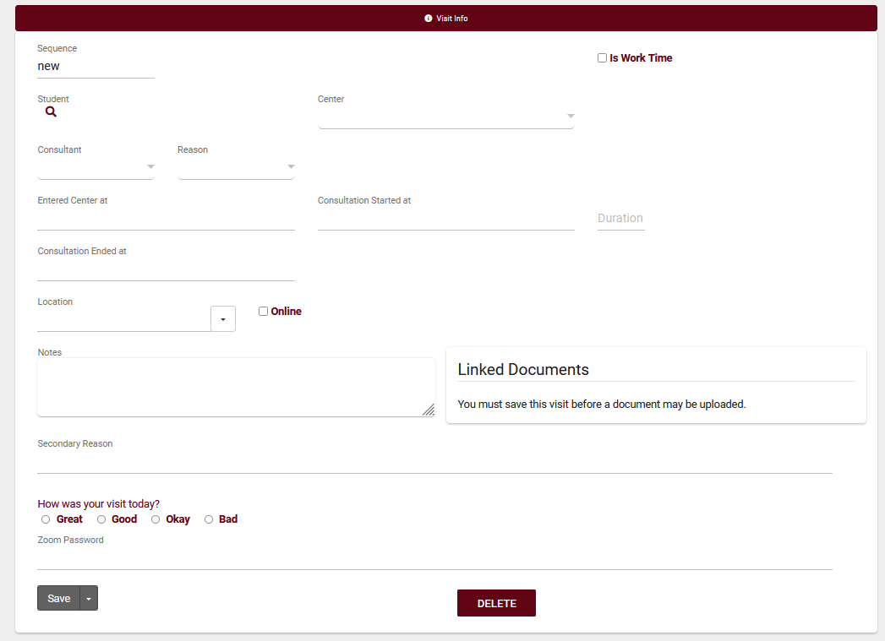
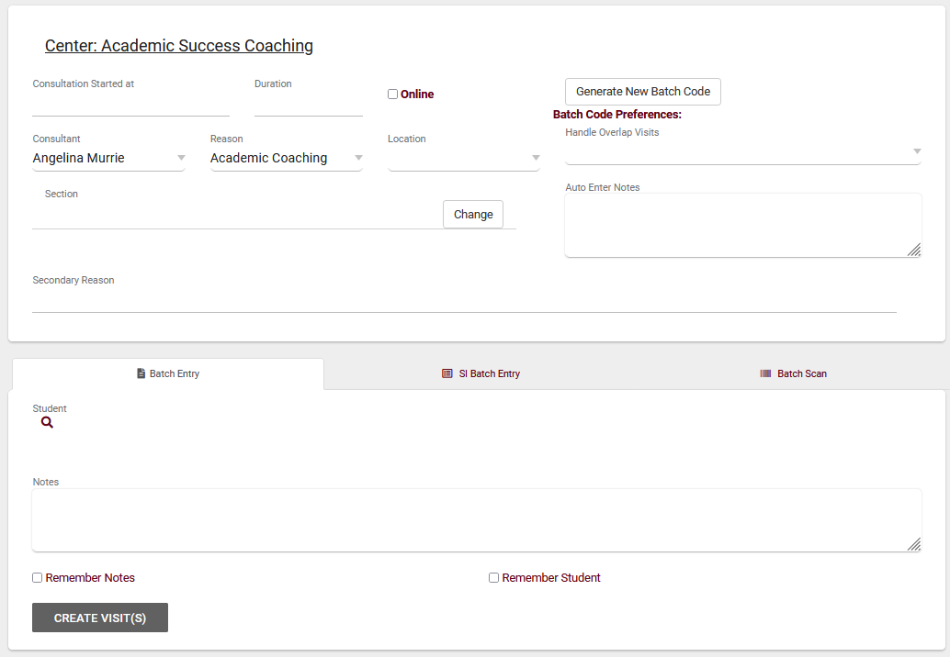
Quick and Batch Visits
Quick visits are a way to manually enter undocumented visits.
This form can record all data that a normal visit record would capture; including fields such as the consultant, student, subject, reason, custom fields, etc.
Batch visits allow you to capture multiple visits where students have a session with the same consultant, reason, notes, time in, and time out.
This tool can be used for workshops, SI sessions, or sessions that take place outside of the classroom/center.

Slide 12
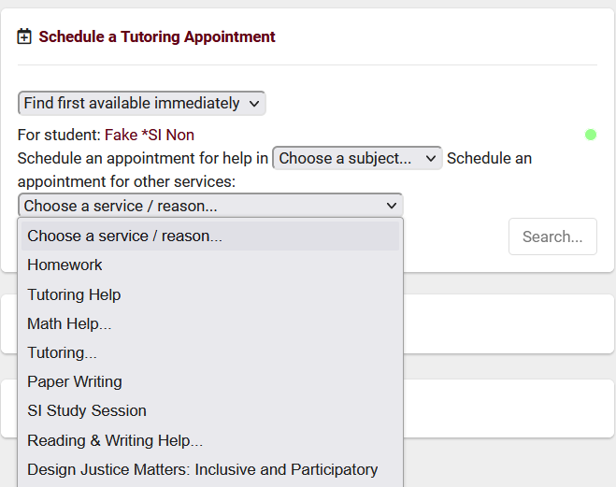
Reasons
Reasons are another layer to the student search, allowing for students to specify the services they are looking for.
Reasons can be used for availability searches, group different types of services, and much more.
Reasons can also be used to define visit time and identify logins from different aspects of the system.

Slide 13
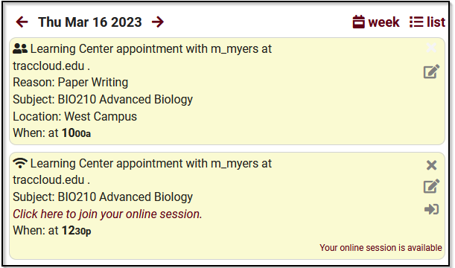
Upcoming Appointment Display
This icon will appear on both the staff and student dashboard whenever an appointment is booked.
If the appointment is online, then a link can be provided to the student; when selected, it will mark a meeting as Attended (in accordance with profile preferences).
The format for this icon can be changed using HTML and Twig!
Be sure to check out my “Personalizing Cloud” session for more information on Twig!

Slide 14
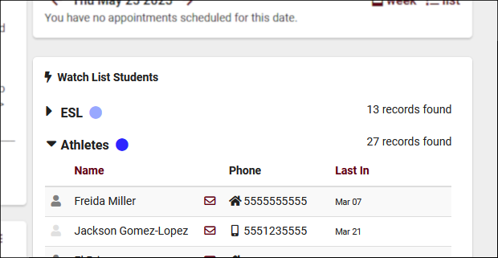
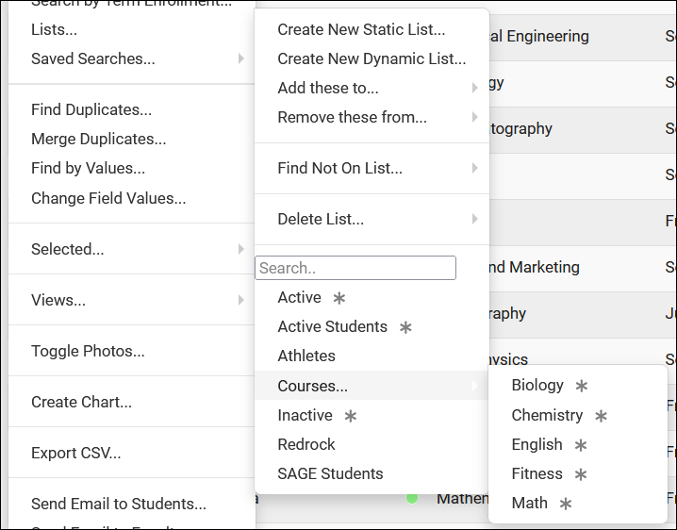
Lists
Static Lists are a manually managed list of students.
Dynamic Lists are based off of a student search that updates automatically.
Watch Lists will appear on your Sysadmin dashboard. This list can be static or dynamic.
For more information on the Lists, check out Luis’s “List Management” session!

Slide 15
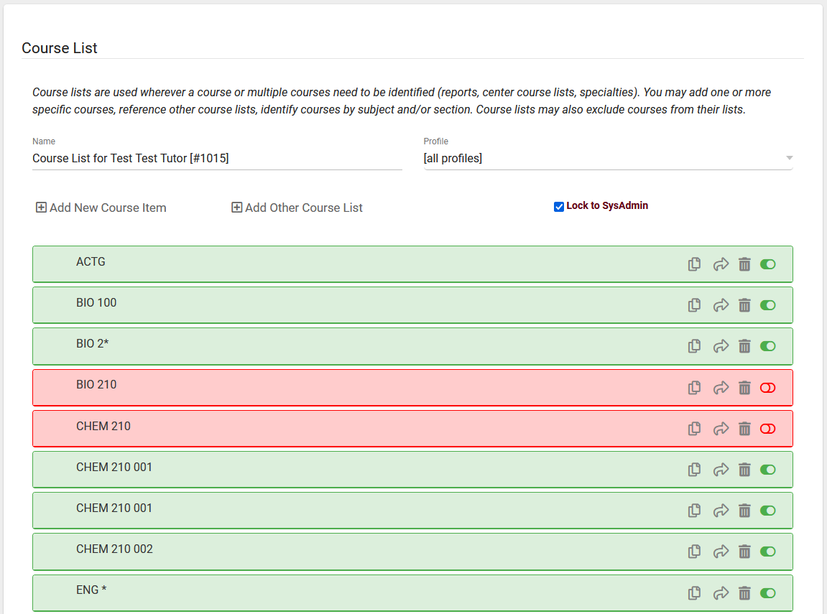
Course list
Course Lists are used to identify the subjects offered by a consultant, center, and even availability. It also specifies the subjects for which a consultant or center does not provide services.
Wildcards are used to define the rest of a statement. For example, ENG* means that all ENGLISH courses are offered by this course list.

Slide 16
Registrations
Registrations are the official records for student enrollment. These records can be marked Active or Inactive by your institution, depending on the students current/past enrollment.

Slide 17
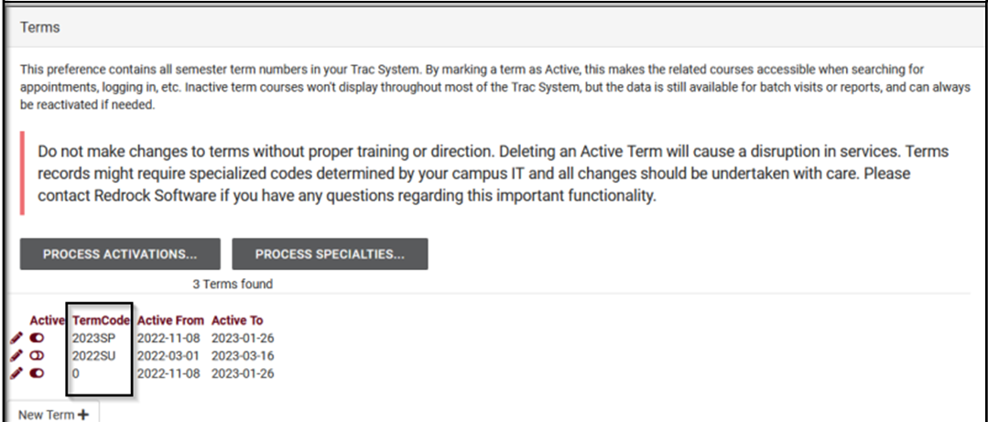
Terms
Terms represent semesters or lengths of time in the system.
Sections and Registrations will use Terms to determine how long they should be active for.

Slide 18
Modules
SurveyTrac
SAGE Early Alert
Success Plans
Text Alerts
Q2 Tables
Starfish Export
Whiteboard
TracCloud offers “Modules” that provide additional functionality to your system.
These modules are at a cost, please reach out to sales for pricing information.
Be sure to attend any module sessions that peak your interest or ask a Redrock tech for more information on a module you are looking into!

Slide 19
10% off new modules and/or profiles if purchased before 5/15/2024

