Slide 1
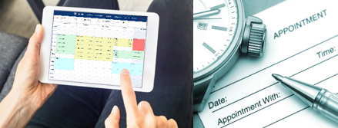
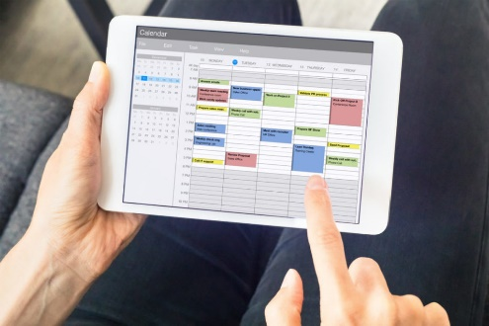
Scheduling Settings & Configuration
Appointments, Availabilities Settings & Reports
Luis Frias
Redrock Software

Slide 2
Topics We Will Cover
What's new with Scheduling Rules
Profile Settings – Center Bio
Group Access
Profile Scheduling Rules
Search Availability Options (Global)
Report on Scheduling data

Slide 3
What's New With Scheduling Rules
Reminder Emails can be sent a second time – April
Max appointment rules - limit appt booking by number of hours or minutes - April
When students Reply to Scheduling based emails, the emails can be sent back directly to the staff they booked with – April
You can now add custom fields to availabilities – May
Scheduling Widgets searching can be done by Center and Staff. – July
Availability Listing can be exported to CSV – August
Added Location, Center, Modality and Staff choices to Search availability widgets for students and Staff – March 2025

Slide 4
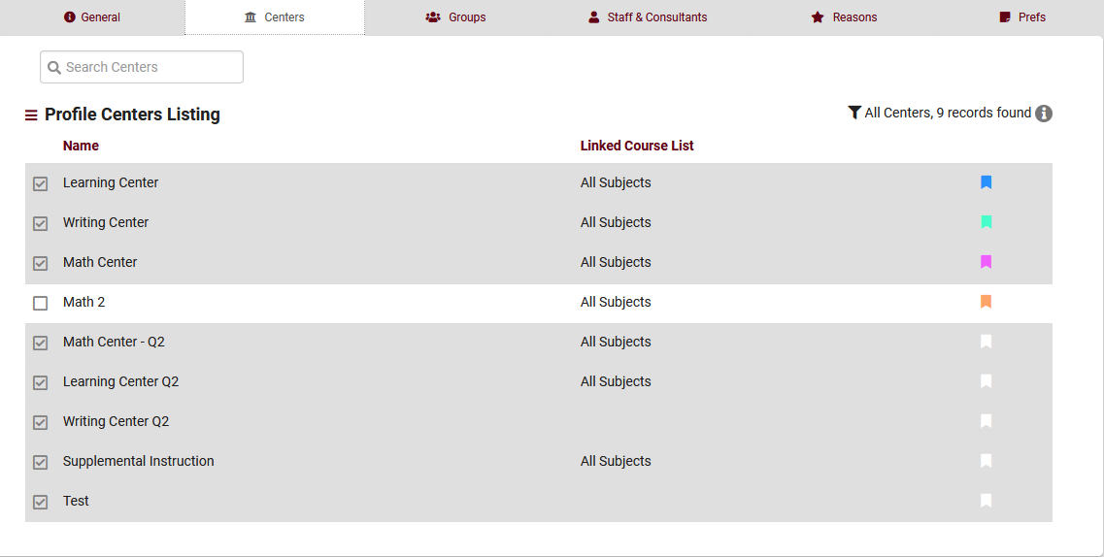
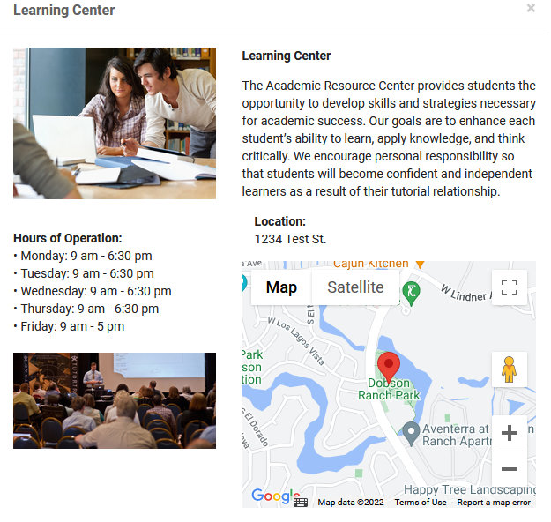
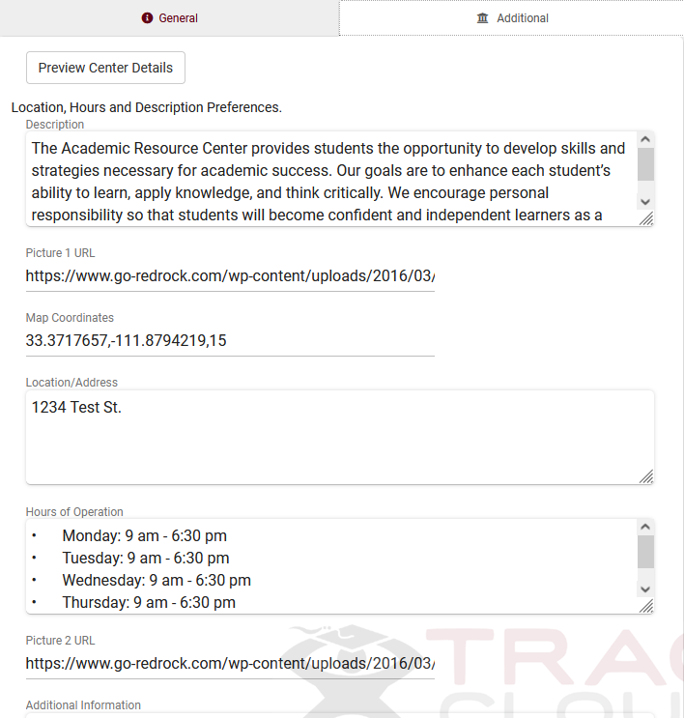
Center Bio
Color code your center(s). This will display as a color marker on the calendar for staff and display for both students and staff when booking an appointment
Create a Center BIO for each of your centers to provide additional details to your students such as location, hours of operation and more!

Slide 5
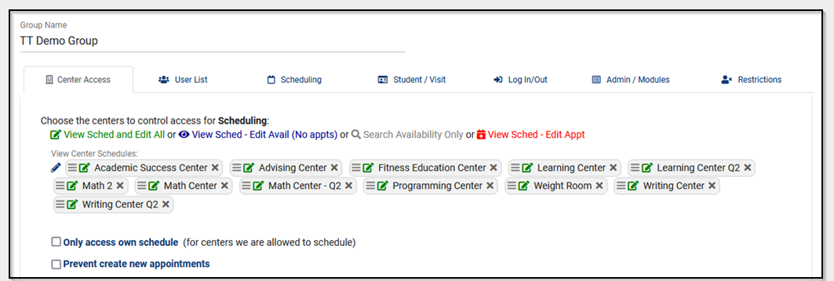
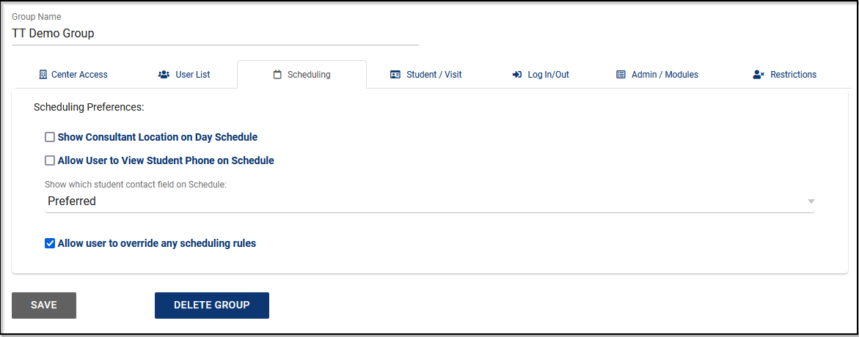
Group Access Center Access & Scheduling
Determine what centers your staff has access to view or schedule an appointment for.
Grant override scheduling rules per group permissions

Slide 6
Profile Settings
Time Restrictions is used to control how soon or how late an appointment may be booked or cancelled
Special Fields is used to control which of the certain fields will be available for entry in Availabilities and Appointments for all centers linked to this profile
Other Schedule Options is used to control certain additional access restrictions to appointment scheduling functionalities
Appointment status choices is used to list all the appointment statuses that you will use to track appointments
Max appointment rules are used to prevent too many appointments from being booked by a student or multiple students for a certain period of time
Appointment Display is used for controlling how an appointment is displayed to the various users using Twig commands.

Slide 7
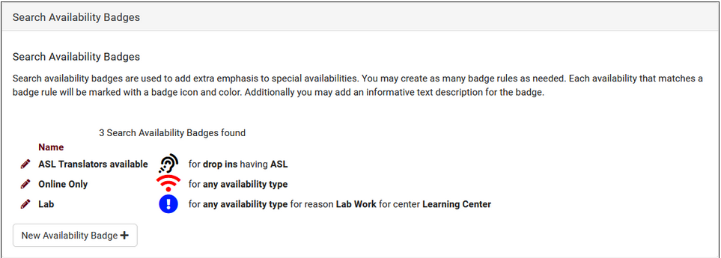
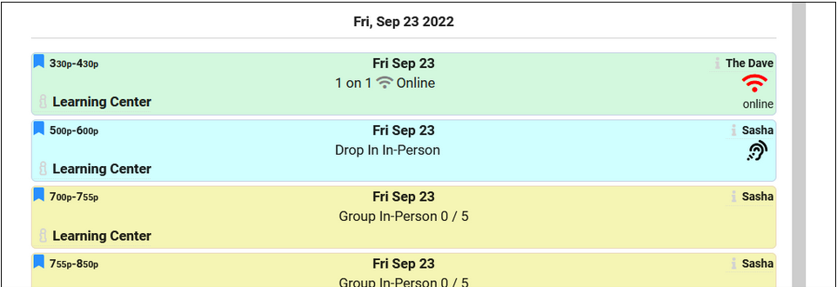
Search Availability Badges
Search Availability badges can be used to add information and indicators to availability slots. Each badge can appear in specific contexts, based on center, section, location, skills/accommodations, etc.

Slide 8
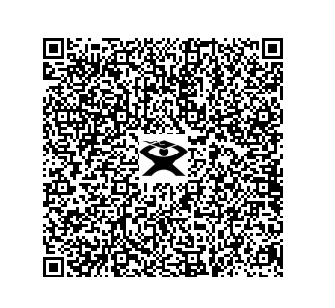
Schedule with Me
Student INFO Password: 1918 User: 1918

Slide 9
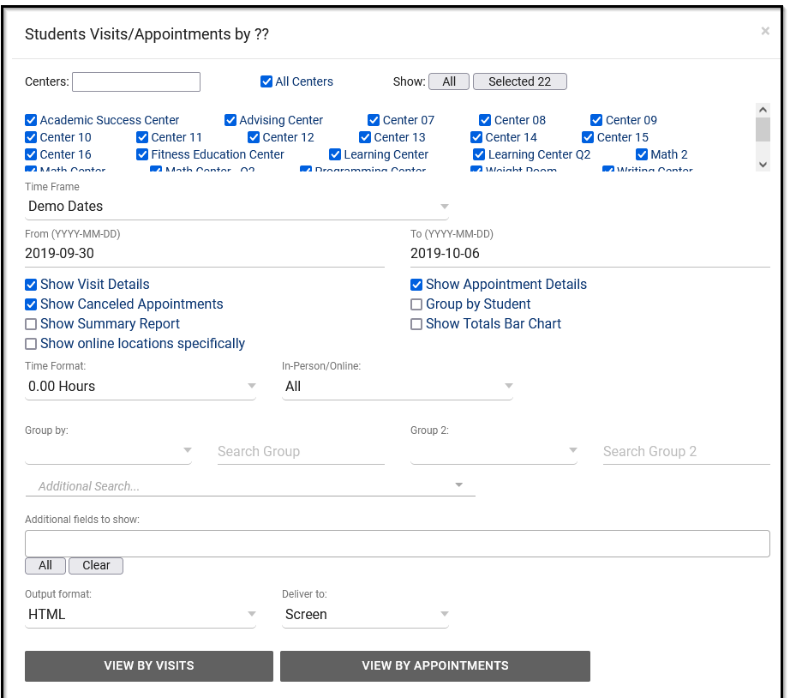
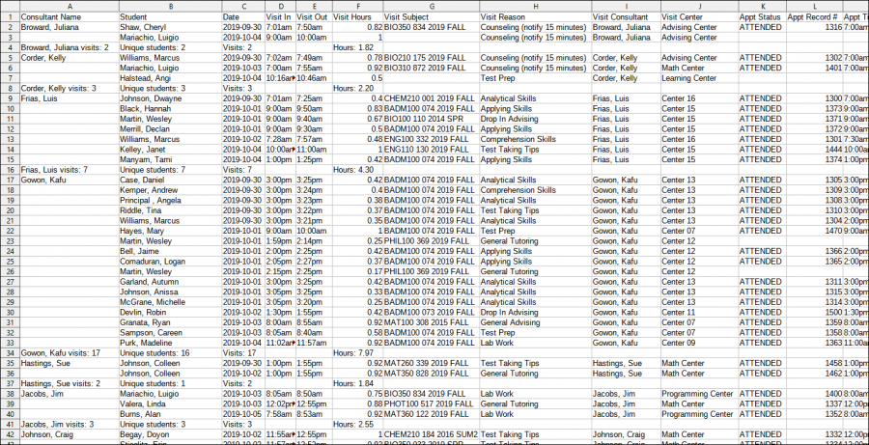
Reports
Consultant Specialties- List the Subject or Subjects and sections each staff member specializes in. This Report can even specify which specialties for which consultants in a specific center.
Outstanding Appointment Request – Will allow you to view all outstanding request for appointments. Any student who was not able to find an availability can report and then request assistance
User Detail – Report - This report will display Each Staff and the details of there account. The is useful to ensure all staff have a group, Email, and phone numbers assigned to their account.

