Slide 1
Communicating with users by email or text
Confirmations, cancellations, notifications and more over email and text
Aidan murray

Slide 2
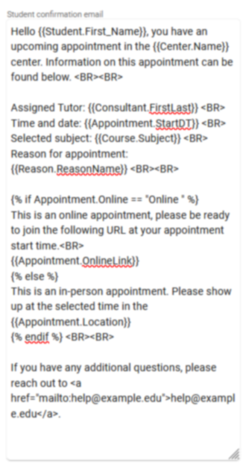
emails
Customizing your automated traccloud emails with twig and html
Add Twig Tags to dynamically pull information into your email templates.
Use Twig to add logic to your emails, making even entire paragraphs change based on appointment/visit context.
Use HTML to stylize the content of emails, changing font sizes, embedding images, and more.

Slide 3
Profile Email types
Confirmation – Typically sent the moment an appointment is booked.
Reminder – Typically sent the day before/morning of an appointment.
Cancellation – Instantly sent when an appointment is cancelled.
Missed Appointment – Sent when an appointment is set as Missed or automatically overnight.
Auto Cancellations – If a student misses/cancels consecutive appointments from a recurring series.
Visit and Visit Duration – Optional additional emails tied to visits.
Send Visit Notes – A staff-initiated email that can be sent to any user.
Resource Checkout – Emails sent to confirm a resource checkout or notify when overdue.
Workshop Emails – Confirmations, cancellations, and reminder emails for workshop enrollment.

Slide 4
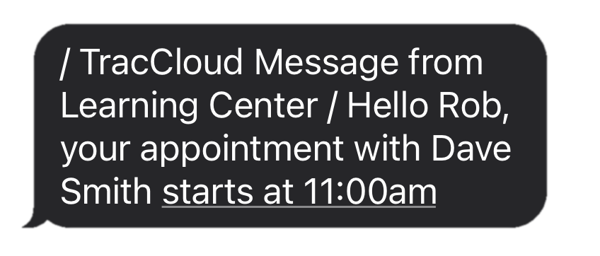
Textalerts allows you to:
Send appointment confirmations, cancellations, and reminders via text.
Send a text to students from their profile or from the log listing for currently logged in students.
Give students the ability to opt themselves into/out of SMS alerts via Confirm Bio.
Give students the ability to sign themselves up for drop-in availability reminders.

Slide 5
typical html usage in traccloud
What you enter
How it displays
<b>Hello!</b>
<i>Here’s a link:</i>
<a href=“https://www.go-redrock.com”>Clickable link</a>
<img src=“https://www.go-redrock.com/wp-content/uploads/2021/07/TutorTrac_icon_burgundy_gradient-01.png”>
Hello!
Here’s a link:
Clickable link

Slide 6
typical twig usage in traccloud
What you enter
How it displays
Hi {{Student.First_Name}}!
{% if Appointment.Online = “Online” %} This appointment is online! {% else %} This appointment is in-person! {% endif %}
Hi Alex!
This appointment is online!
A list of tags and more can be found on our wiki.
wiki.go-redrock.com/index.php/TracCloudGuideProfilePrefsTwig

Slide 7
Other trac system emails
Email Templates – Save pre-written emails that you can send later, including file attachments.
Document Emails – Emails can be automatically sent to students and/or consultants when a document is uploaded to an appointment.
Notifications – Allow your staff to send a notification to a student, which can be in the format of an email or a pop-up on the student’s dashboard.
Faculty Emails from Student Listing – Search for students, and send an email to faculty of their registrations.

