Slide 1
Resources
How to manage and set up your lending library
Bill Bennett

Slide 2
What’s a Resource?
Resources are items that can be checked in/out of your profile or system.
Resources could be materials such as textbooks, calculators, laptops, or anything else of value that you may lend out to students.
TracCloud will allow you to check resources in/out, track their history, activity, and report on all of the data recorded.

Slide 3
Resource Types
Resources can be divided into different ‘types,’ such as books, Electronics, etc.

Slide 4
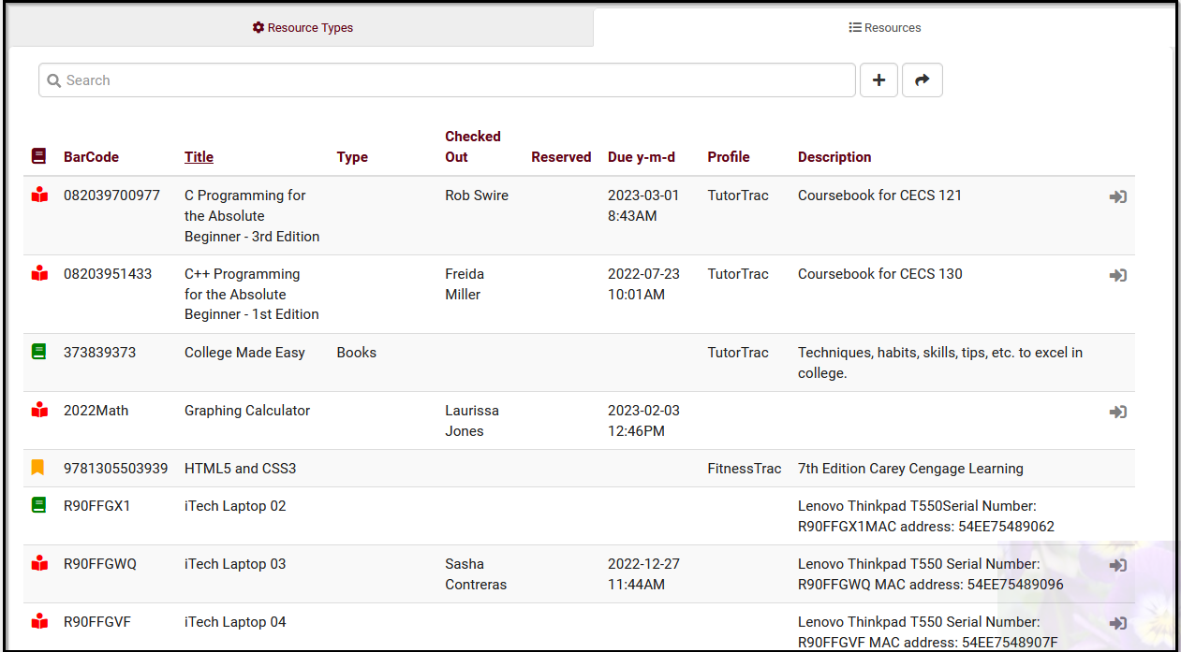
Resource icons
Inactive
Active
Reserved
Checked Out

Slide 5
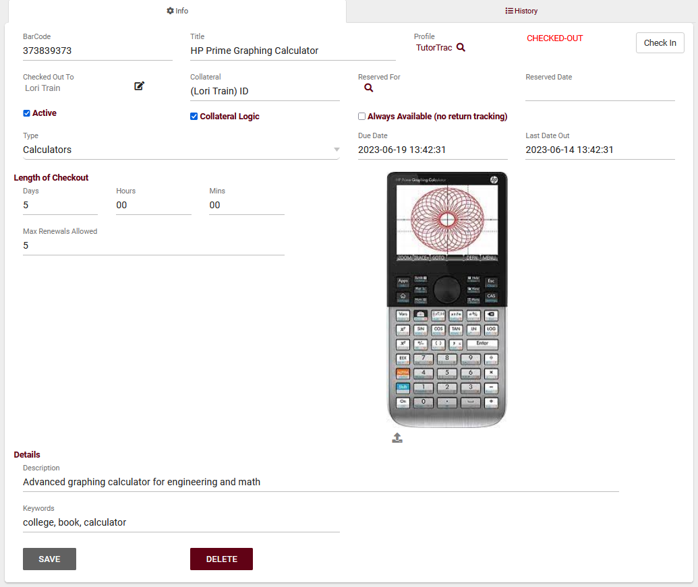
Creating a Resource
BarCode is the unique identifier for this item, think of it like an ID.
Title is the name of this resource.
Profile is the linked Profile for this resource.
Checked Out To shows which student currently has this item checked out (if applicable).
Collateral represents an item to be collected when this resource is checked out.
Collateral Logic enables collateral functionality if checked.
Reserved For shows who currently has this resource reserved.
Always Available indicates that this resource doesn't need to be individually checked out or reserved (Example, towels for fitness center).
Reserved Date, Last Date Out, and Due Date display the exact times of reservations, checkouts, and when the resource is due to be returned.
Resource Type allows you to categorize this resource into a type for reporting purposes.
Length of Checkout determines how long an item can be checked out.
Max Renewals Allowed determines how many times a checkout can be renewed.
Description is an internal description of this particular resource.
Keywords are the related words for this resource to be searched by.

Slide 6
Resource Email
Other > Other Options > Profile > Email > Resource Checkout Email
Resource confirmation and overdue emails can be customized using Twig and HTML.

Slide 7
Permission Groups
Other > Other Options > Groups > [Your Group] > Log In/Out
Allow user to log resources in and out provides users in this group the ability to record resource usage.
Allow user to view what resource the student has logged out provides users in this group the ability to view a student's currently logged out item.

Slide 8
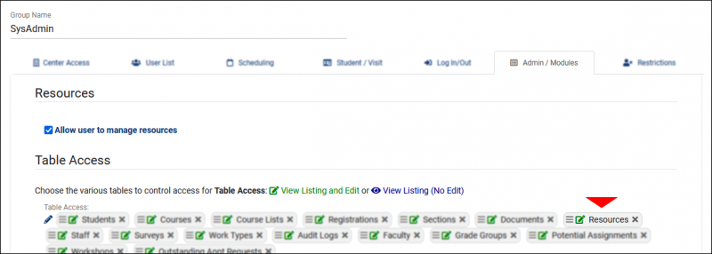
Permission Groups
Other > Other Options > Groups > [Your Group] > Admin/Modules
Allow user to manage resources provides the ability to modify resource records.
Table Access provides access to the Other > Listings > Resources view of resources.

Slide 9
Terms and Conditions
TracCloud allows you to link a “Terms and Conditions” document to a resource type. This allows you to convey the policies around this resource type and record student acknowledgement.
Other > Resources > [Select Resource Type] > Logout Notice to Student (Terms and Conditions)
We can choose to display this policy and require student initials; along with emailing the Terms and Conditions to the student once the resource is checked out.

Slide 10
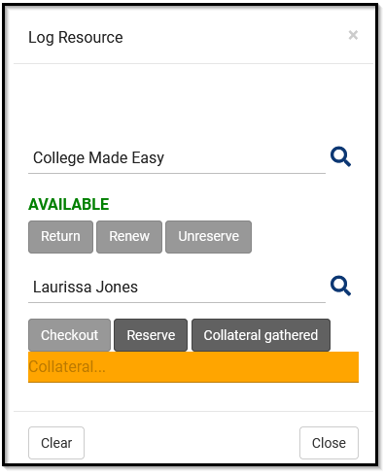
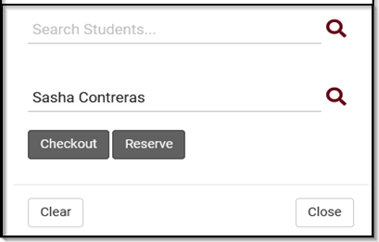
Logging resources
Other > Log Resource
Search an item by keywords to get a filtered list of resource options that are available to check out.
Using a student ID, identify the student that is checking out or reserving a resource.
If item has collateral: A student may need to leave their Student ID Card to check out an item, which they will get back upon returning the item.
Resource Items can now to checked out to staff members!

Slide 11
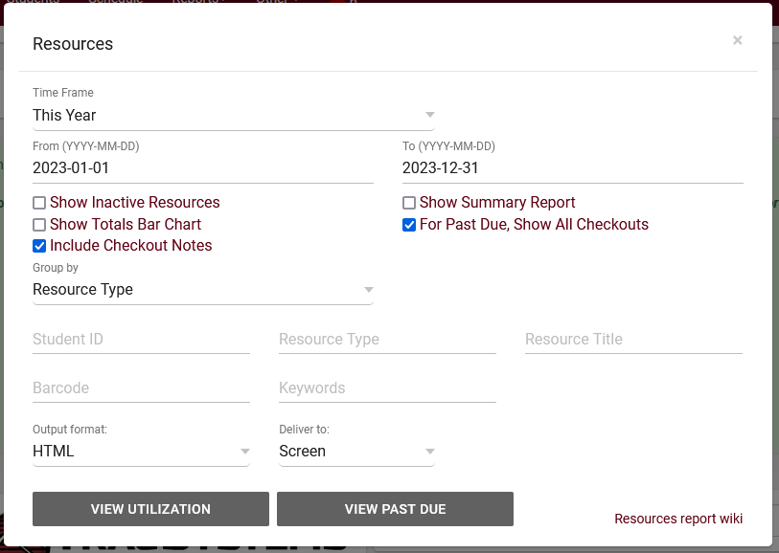
Resource reports
This report shows the students and staff who have checked out a particular resource, the checkout date and time, as well as total hours. This can either be run on overall Utilization, or specifically on Past Due resources.
Reports has the option for CSV export (Raw data) or with grouping totals.

Slide 12
10% off new modules and/or profiles if purchased before 5/15/2024

