Slide 1
Jurassic Bytes
Reviving Security in the Digital Age with TracCloud
(yes I know the title changed, don’t worry I moved it to part two)
Notes:
Let's start our journey by looking back at the technical evolution from 2016 to 2024.
This timeline not only showcases our growth but also highlights the escalating demands on security as our infrastructure complexity and scale have increased.
From running a single server setup in 2016 to managing a robust ecosystem of 70 servers in 2024, the journey has been remarkable.
Each step, from the adoption of newer Ubuntu and PHP versions to the integration of advanced AWS technologies like Aurora RDS and ElastiCache, reflects our commitment to leveraging cutting-edge technology for enhanced performance and security.

Slide 2
Technical Information (2016)
Ubuntu 16.04
PHP 7.0
MySQL 5.7
Memcached 1.6
Servers: 1

Slide 3
Technical Information (2018)
Ubuntu 18.04
PHP 7.1
MySQL 5.7
Memcached 1.6
Servers: 4

Slide 4
Technical Information (2020)
Ubuntu 20.04
PHP 7.4
MySQL 8.0
Memcached 1.6
Servers: 8

Slide 5
Technical Information (2022)
Ubuntu 22.04
PHP 7.4 (8.0 in development)
Aurora RDS 2.0 (MySQL 8) (3.0 in development)
Memcached 1.6
Servers: 14

Slide 6
Technical Information (Early 2023)
Ubuntu 22.04
PHP 7.4 (8.1 in development)
Aurora RDS 3.0 (MySQL 8)
ElastiCache (Memcached)
Servers: 30

Slide 7
Technical Information (Fall 2023)
Ubuntu 22.04
PHP 8.2 (8.3 in development)
Aurora RDS 3.04 (MySQL 8)
ElastiCache (Redis)
Servers: 50

Slide 8
Technical Information (Early 2024)
Ubuntu 22.04 (24.04 in development)
PHP 8.3
Aurora RDS 3.06 (MySQL 8)
ElastiCache (Redis)
Servers: 70

Slide 9
AWS Technologies In Use
Elastic File System
ElastiCache
RDS
Aurora Cluster
Serverless
Secrets Manager
Systems Manager
Parameter Store
Fleet Manager
Run Commands
Inspector
S3
Key Management Service
Route 53 (DNSSEC)
AppConfig
Elastic Load Balancing
Certificate Manager
Lambda
EventBridge
CloudWatch
Notes:
Our reliance on AWS technologies has been pivotal. From Elastic File System to CloudWatch, these tools have not only bolstered our infrastructure's resilience but also enriched our capabilities to monitor, manage, and secure our environment effectively

Slide 10
Service Layout
Notes:
Visualizing our service layout provides a clear picture of how our complex systems interlink and operate harmoniously. This integration is key to maintaining not only performance but also a fortified security posture

Slide 12
Highlight: Deployment
Zero Downtime
No Users Affected
Rollback-capable
Speed vs. Reliability
Philosophy Changes
Notes:
A critical aspect of our evolution has been our deployment strategies and the iterative improvements across versions.
Achieving zero downtime and ensuring rollback capabilities, while balancing speed and reliability, underscores our philosophy that security and efficiency are not mutually exclusive.

Slide 13
V1

Slide 14
V2

Slide 15
V3

Slide 16
V4

Slide 17
V5

Slide 19
V9

Slide 20
Enough With the boring Stuff

Slide 21
What’s Does it mean?
Performance
50ms average
250ms (1% low)
Scaling
Static to dynamic
Logging & Monitoring
CloudWatch Logs
CloudWatch Metrics
CloudWatch Dashboards
Security
NIST SP800-53 rev 5
1200+ controls and enhancements, evidence sources
Mountains of Data

Slide 22
Resource Footprint
70+ EC2 Instances
Dozens of AWS Managed Instances
110GiB Documents, Photos, Uploads
750GiB Raw Data
1,675GiB Logs
16,032GiB Backups

Slide 24
Enough With the boring Stuff For real this Time

Slide 25
The Sixth Sense
TracCloud's Intuition for Unseen Threats

Slide 26
Cybercrime & Ransomware
$9,500,000,000,000 USD in 2024
$3,000,000,000,000 in 2015
Ransomware:
$42,000,000,000 in 2024
30% year over year
$265,000,000,000 by 2031
74% increase compared to 2023
4,800 companies
LockBit: 1,000
Damage and destruction of data
Stolen money
Lost productivity
Theft of intellectual property
Theft of personal and financial data
Embezzlement
Fraud
Post-attack disruption to the normal course of business
Forensic investigation
Restoration and deletion of hacked data and systems
Reputational harm
Legal costs
Regulatory fines
Notes:
Consider this: Cybercrime costs have soared to $9.5 trillion in 2024, with ransomware damages alone hitting $42 billion. The threat is not just to our data but to our very way of life. It's a stark reminder of the world we navigate

Slide 27
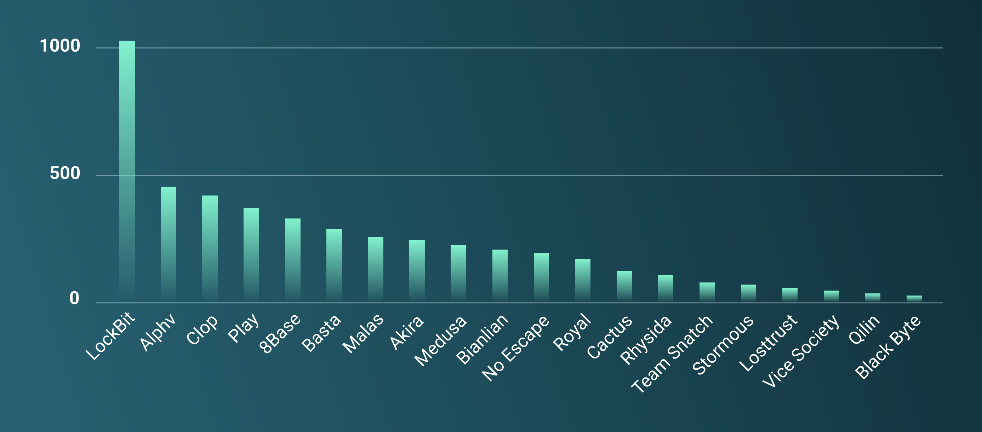
Ransomware Groups

Slide 29
Time for some Good News
MTTR 3.4 days to 2.6 days
Some level of AI: 58 minutes
Full use of AI: 7 minutes
Mainstream knowledge of security & privacy
Phishing awareness
MFA requirements
Business leaders
Law enforcement is getting better
ALPHV
Hive

Slide 30
New Responses & Tools
Zero Trust Architecture
Remote Work
Device permissions -> User permissions
Behavioral analytics
Large log data set monitoring
Homomorphic encryption
Automation
Defensive AI / Machine Learning
Organizational standards
Consolidation of government resources & standards
Software bill of materials

Slide 31
What can we All Do?
Non-Technical Users:
Strong & unique passwords
2FA
Be skeptical of emails & calls
Software updates
Secure Wi-Fi use
Backups
VPNs (sometimes)
Credit Monitoring / Freezing
Technical Users:
Least privilege principles
Secure coding practices
Network segmentation
Incident response planning
Encryption
Regular security audits
Penetration testing
IDPS at home
PASSWORD MANAGERS!!!!

Slide 32
VPN Recommendations
(Not financial advice)
Nic’s Personally Trusted Providers:
Proton
Mullvad
Private Internet Access
Surfshark
ExpressVPN

Slide 33
Password Managers
BitWarden
1Password
Avoid LastPass at all costs

Slide 34
Redrock’s Mission
Confidentiality, Integrity, Availability
Compliance with standards
Implement advanced technologies
Foster a security-aware & focused culture
Continuous improvement & adaption
Robust policies and procedures
Customer Data is literally sacred
Notes:
At Redrock, our mission is clear: to uphold confidentiality, integrity, and availability, aligning with compliance standards and leveraging advanced technologies.

Slide 35
TracCloud Security Tools
AWS Security Hub
Compliance Packages
AWS Inspector
SBOM
Very fast CVE exposure identification
AWS CloudWatch
300 Alarms
AI powered anomaly detection
Log monitoring
AWS Audit Manager
Evidence collection

Slide 36
The Wizard of Logz
TracCloud's Magical Audit Trail

Slide 37
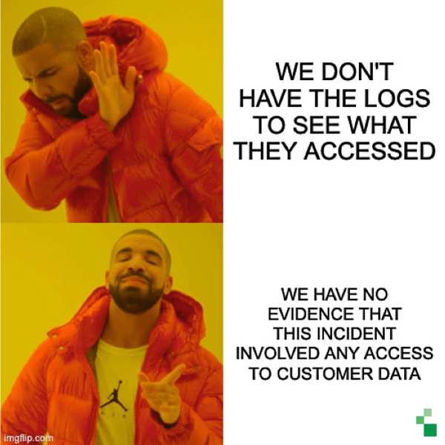

Slide 38
Logs, Events, Audits
Requests
Data passed between server and client
Events
User actions
System events
Audits
Record reads & writes
Logs
Messages
Notices

Slide 39
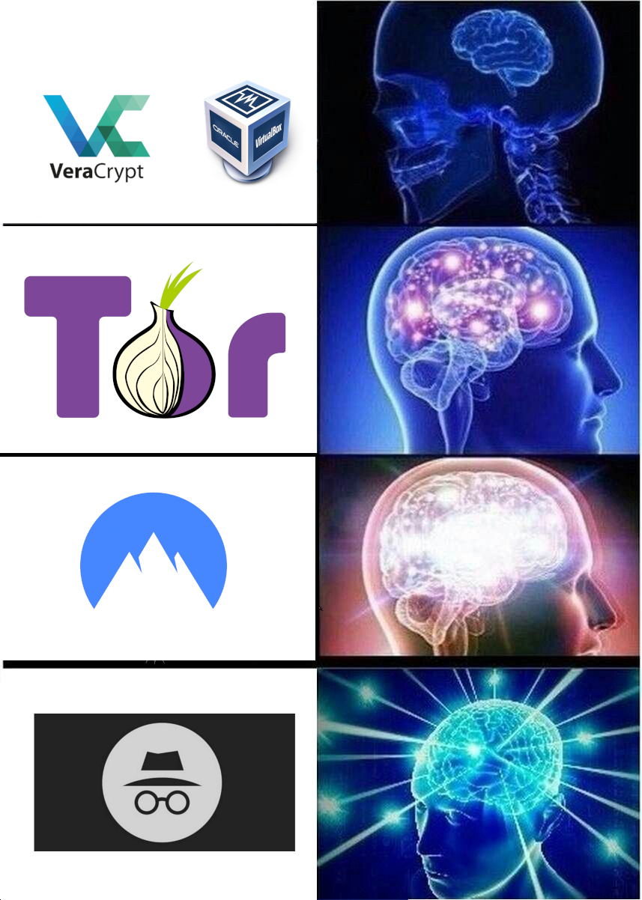
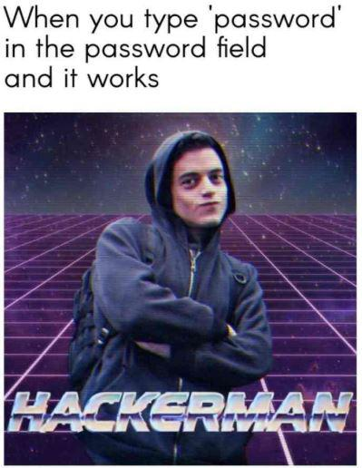
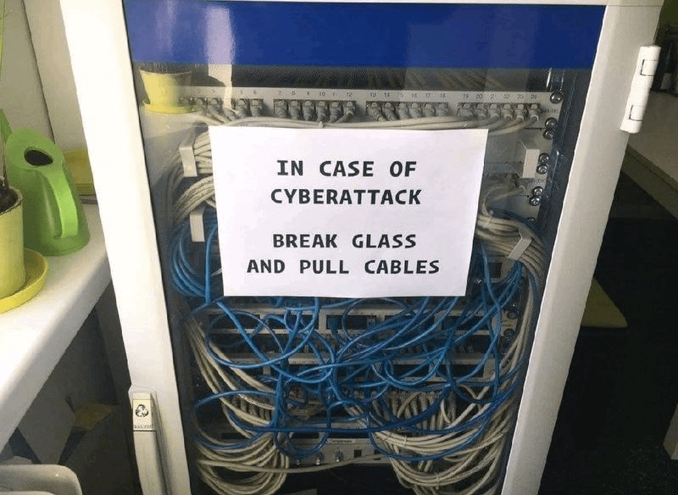
Q & A

