Slide 1
Communicating with your students & staff
Confirmations, cancellations, notifications and more over email and text
Aidan Murray

Slide 2
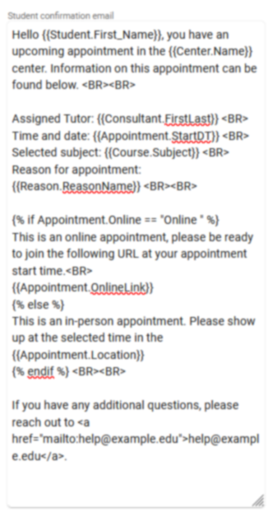
emails
Customizing your automated traccloud emails with twig and html
Add Twig Tags to dynamically pull information into your email templates.
Use HTML to stylize the content of emails, changing font sizes, embedding images, and more.
Use Twig to add logic to your emails, making entire even entire paragraphs change based on context.

Slide 3
Textalerts allows you to:
Send appointment confirmations & cancellations via text.
Remind students & consultants of their appointments by text shortly before the appointment time.
Send a text to students currently visiting your center.
Broadcast messages to multiple students at once.
Students are opted-in to TextAlerts by default, but they can also be given the ability to opt out if needed.

Slide 4
typical html usage in traccloud
What you enter
How it displays
<b>Hello!</b>
<i>Here’s a link:</i>
<a href=“https://www.go-redrock.com”>Clickable link</a>
<img src=“https://www.go-redrock.com/wp-content/uploads/2021/07/TutorTrac_icon_burgundy_gradient-01.png”>
Hello!
Here’s a link:
Clickable link

Slide 5
typical twig usage in traccloud
What you enter
How it displays
Hi {{Student.First_Name}}!
{% if Appointment.Online = “Online” %} This appointment is online! {% else %} This appointment is in-person! {% endif %}
Hi Alex!
This appointment is online!
A list of tags and more can be found on our wiki.
wiki.go-redrock.com/index.php/TracCloudGuideProfilePrefsTwig

