Slide 1
Post-Pandemic Changes and TracCloud Reporting
New Functionality and Uses

Slide 2
Agenda
A brief overview of UAF
A look at DMS
Our post pandemic challenges & how TracCloud has helped
Math Achievement Services
How we use TracCloud
Changes in our usage and reporting
My Favorite Reports

Slide 3
A Brief Overview of UAF

Slide 4
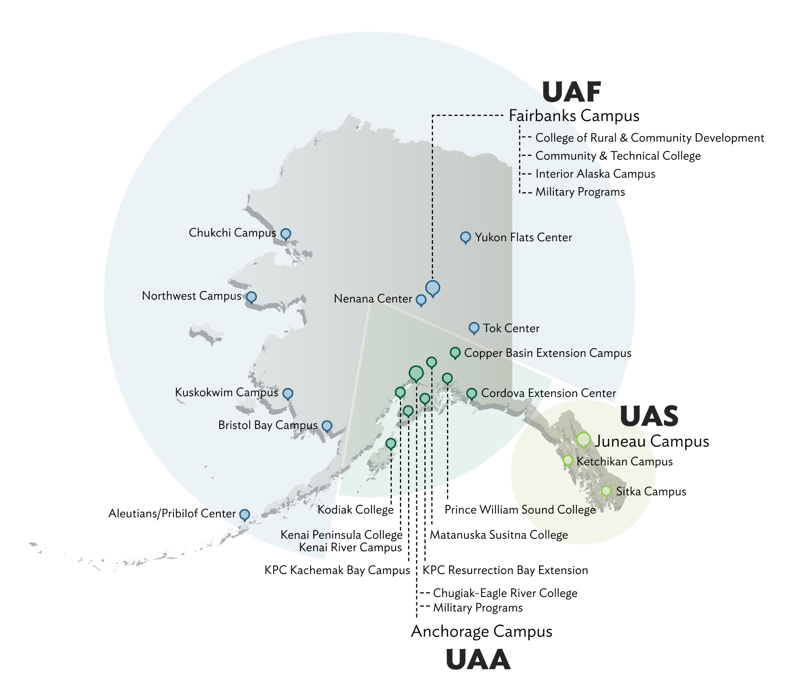
A Brief Overview of UAF
•Seven branch campuses that reach across the state
•89% of the student body is undergraduate
•Enrollment is around 9700
•4500 are in Fairbanks
•62% of these are enrolled in at least one eCampus course (since covid this has increased to about 78%)
•**No centralized tutoring or academic success centers

Slide 5
A Look at DMS

Slide 6
A Look at DMS
•We have 1 Admin Assistant, 16 full-time faculty members (12 in Mathematics and 4 in Statistics) and 2 adjuncts
•**We offer 13 courses (28 sections) that are served in our centers
•We also offer 16 courses (28 sections) of other undergraduate and graduate courses
•**We have 13 TAs and 6 undergraduate student workers

Slide 7
Who are you?

Slide 8
Our Post-Pandemic Challenges & How TracCloud Helped

Slide 9
Our Post-Pandemic Challenges
Fewer faculty members
Larger class sizes
Faculty teaching more sections
More flexibility with courses offerings and modality
Continue to offer asynchronous courses
All undergrad courses have a synchronous option
Some hyflex offerings
Changes in student support
Had to reduce in-person lab hours
Increased 1-1 in-person, individual and group online hours
Increased course support
More flexibility in student support

Slide 10
How TracCloud has helped
Easily able to adjust schedules due to circumstances
Ability to contact/notify students easily about changes
Ability for students and tutors to switch from in-person to online
Continued tracking of remote tutors and graders

Slide 11
Math Achievement Services

Slide 12
Math Achievement Services
We provide tutoring, grading and course support for our GER Math courses
Drop-in lab tutoring 5 days a week
1-1 in-person tutoring 5 days a week
Online tutoring 6 days a week
Provide grading support for 6 of 13 courses
Provide group tutoring for 5 of 13 courses
Provide course support for 5 of 13 courses

Slide 13
How we use TracCloud

Slide 14
How We Use TracCloud
Track center logs
Scheduling in-person and online appointments
Tracking
attendance for course support sessions
required tutoring
tutor hours
grader hours
training/certifications
Reporting
utilization
visits for instructors
payroll

Slide 15
Reporting

Slide 16
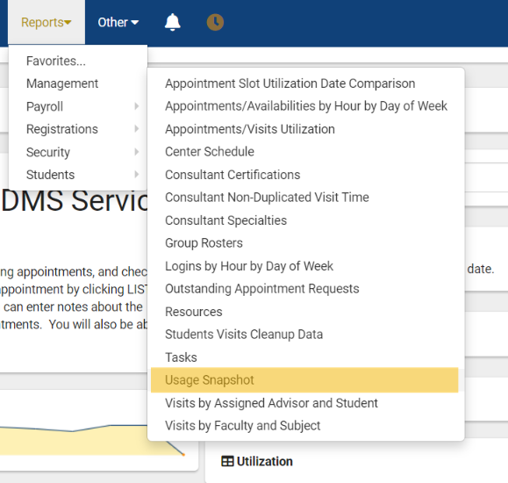
Changes in Our
Usage and Reporting
Utilization Reports
Comparisons between semesters: F-F,SP-SP, F-SP

Slide 18
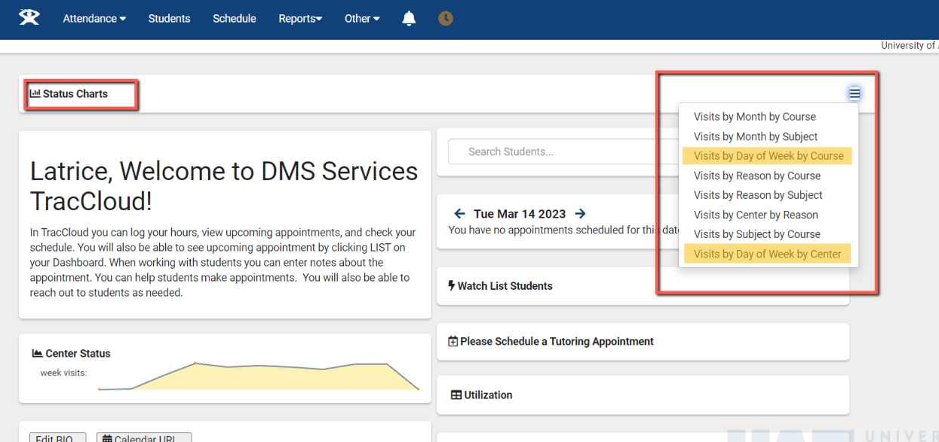
Changes in Our
Usage and Reporting
Utilization Reports
Comparisons between semesters
Semester Information

Slide 19
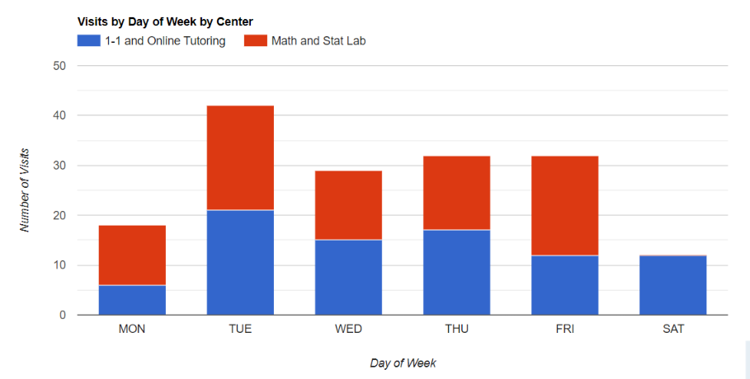
Changes in Our
Usage and Reporting
Utilization Reports
Comparisons between semesters
Semester Information
Breakdowns by Center

Slide 20
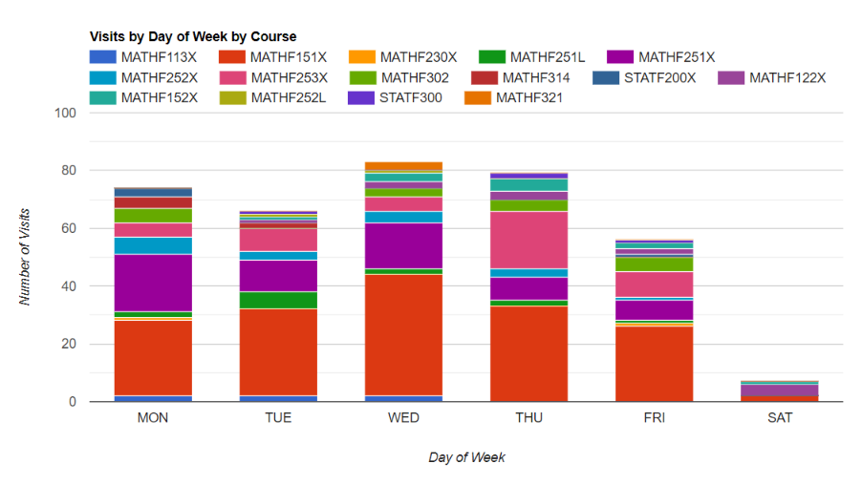
Changes in Our
Usage and Reporting
Utilization Reports
Comparisons between semesters
Semester Information
Breakdowns by Center
Breakdowns by Course

Slide 21
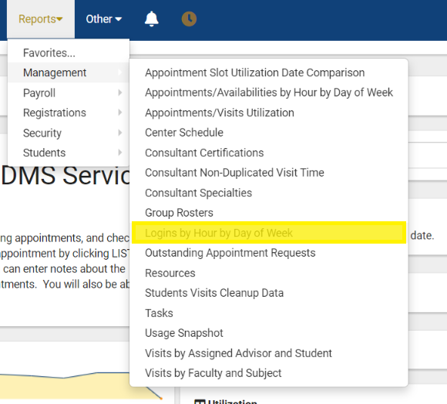
Changes in Our
Usage and Reporting
Utilization Reports
Comparisons between semesters
Semester Information
Breakdowns by Center
Breakdowns by Course
Logins by Hour by Day

Slide 22
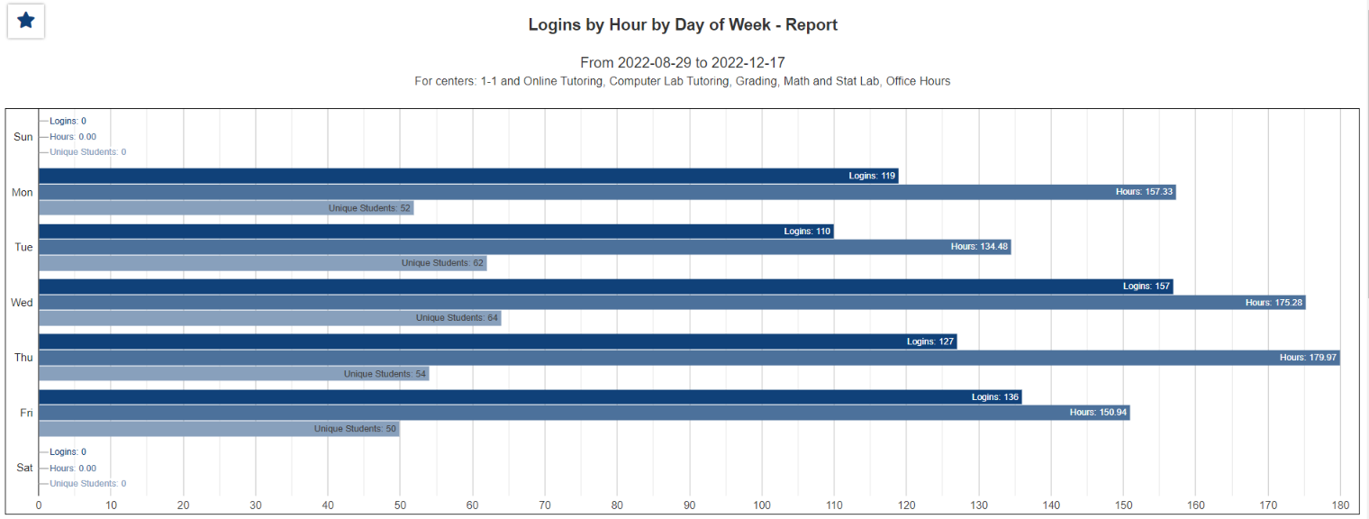

Slide 23
My Favorite Reports
Outstanding Appointment Requests Report
Visit Cleanup data
Visits by Subject/Course/Section
Consultant Certifications
Payroll

Slide 24
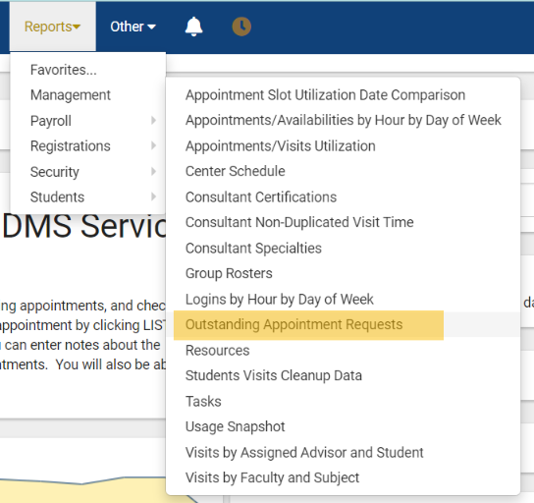
My Favorite Reports: Outstanding Appointment Requests

Slide 25
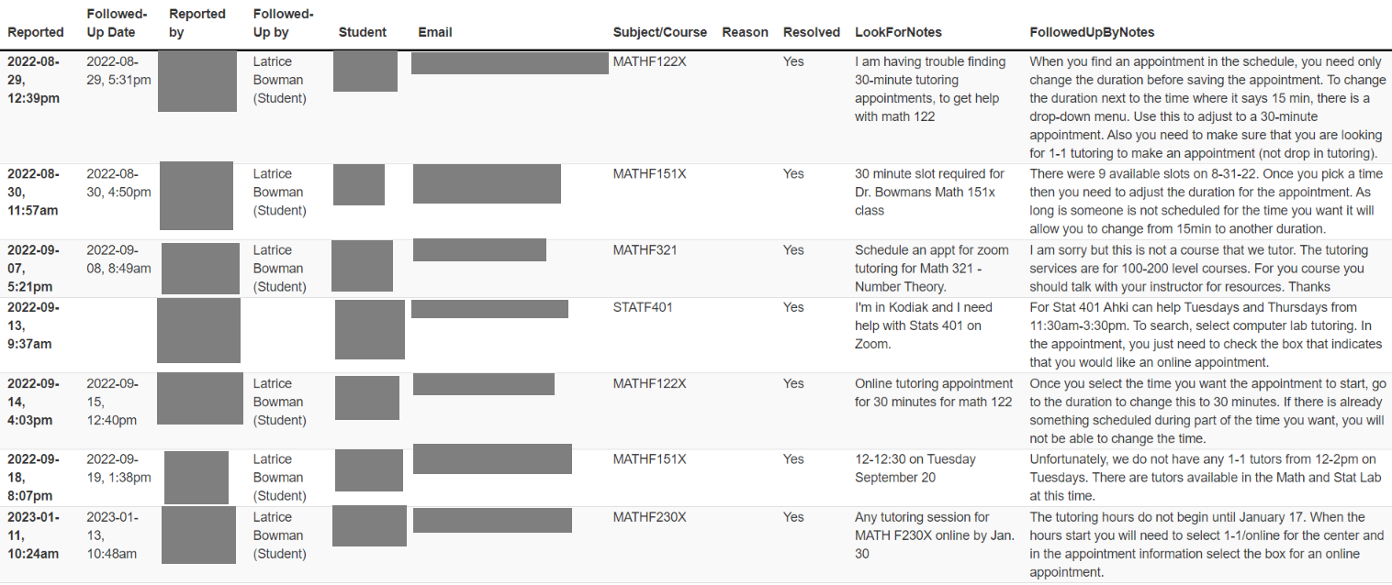
My Favorite Reports: Outstanding Appointment Requests

Slide 26
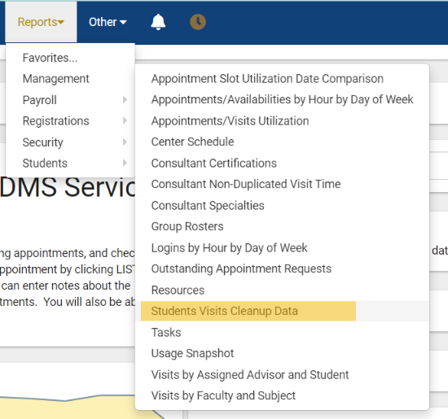
My Favorite Reports: Student Visit Cleanup Data

Slide 27
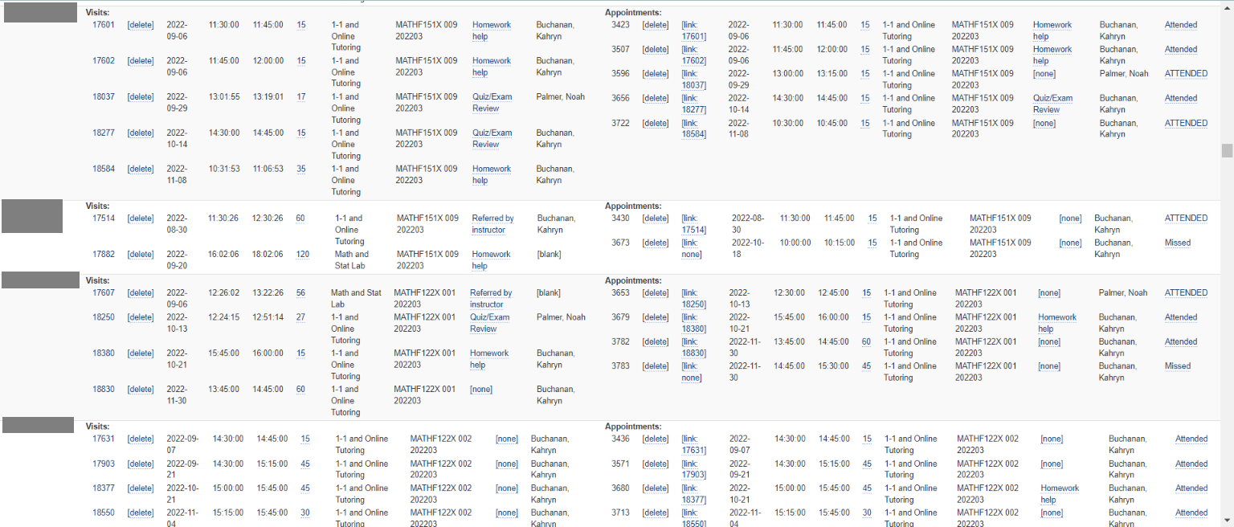
My Favorite Reports: Visit Cleanup Data

Slide 28
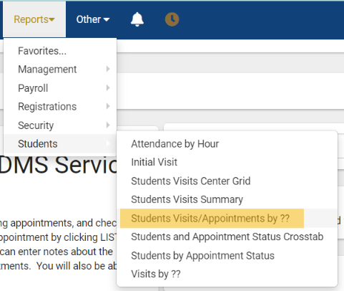
My Favorite Reports: Visits by Subject/Course/Section

Slide 29
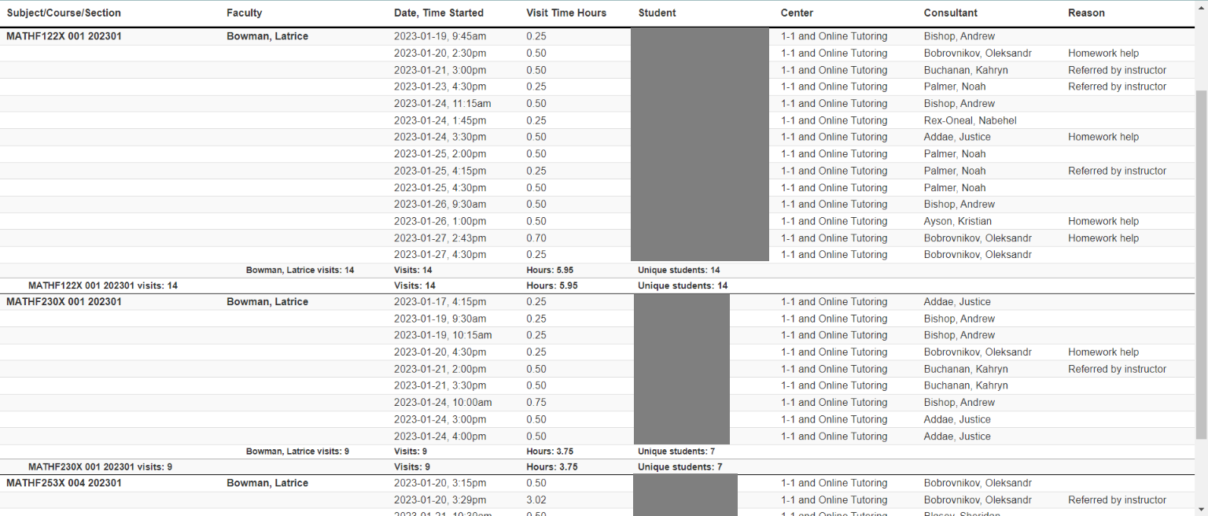
My Favorite Reports: Visits by Subject/Course/Section

Slide 30
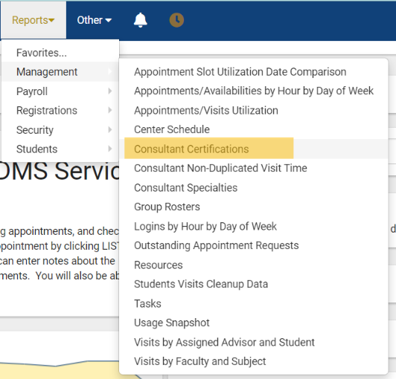
My Favorite Reports: Consultant Certifications

Slide 31
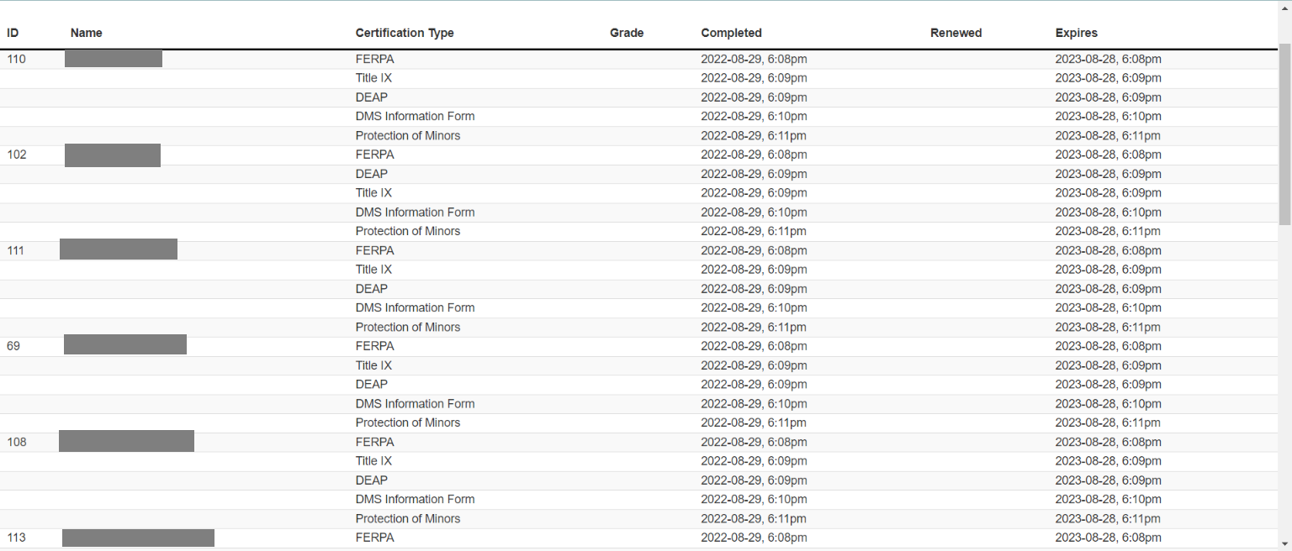
My Favorite Reports: Consultant Certifications

Slide 32
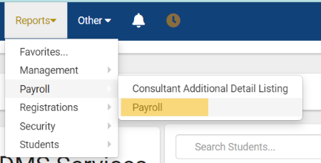
My Favorite Reports: Payroll

Slide 33
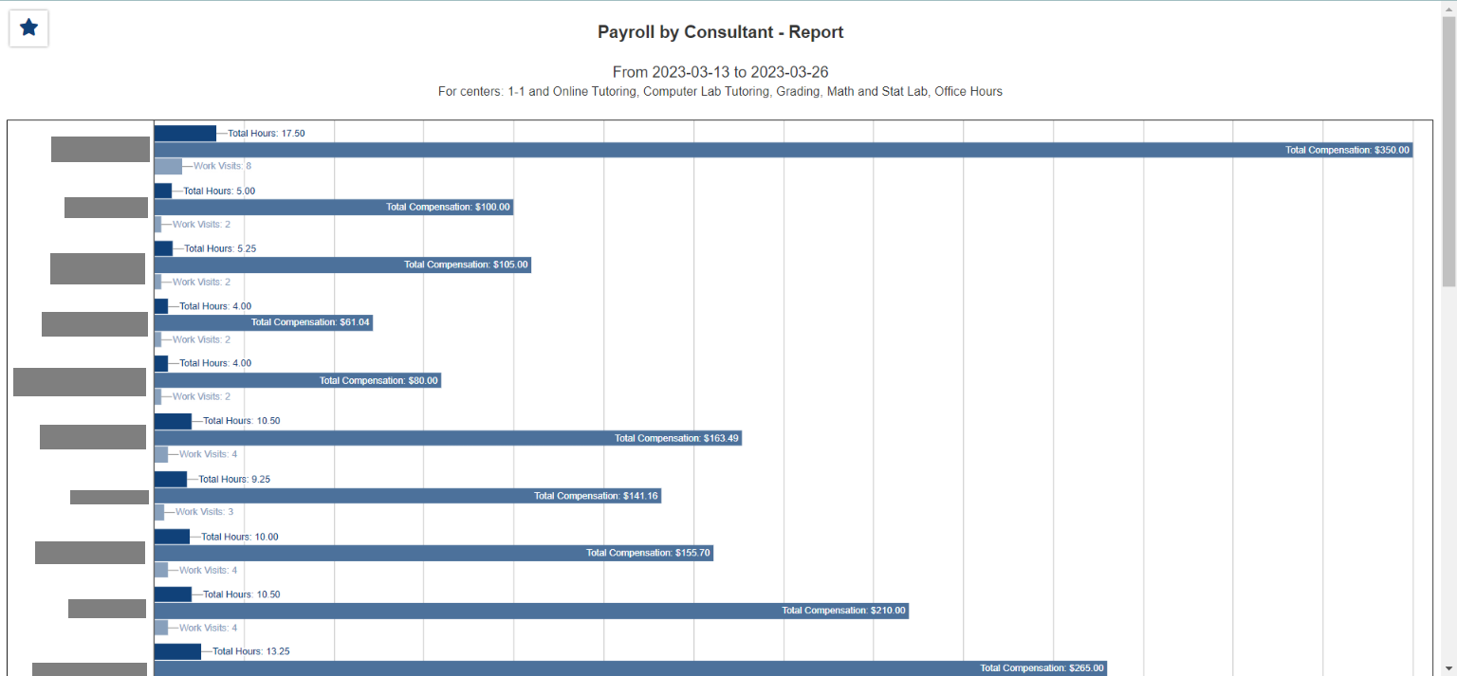
My Favorite Reports: Payroll

Slide 34
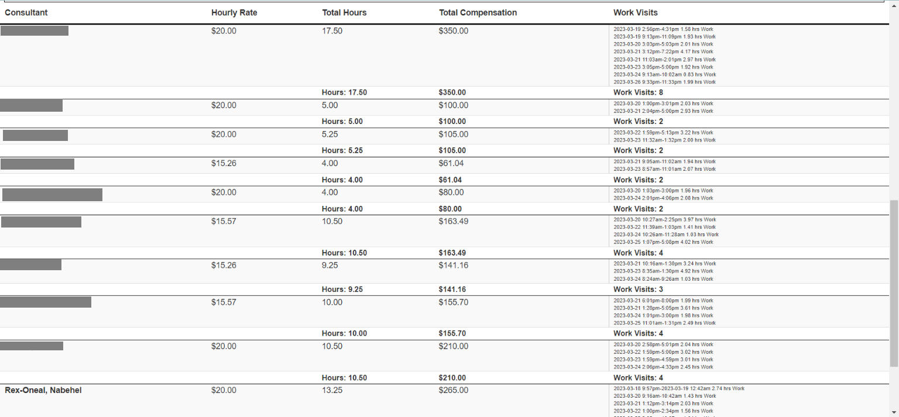
My Favorite Reports: Payroll

Slide 35
Questions???

Slide 36
Thank You
Dr. Latrice Bowman
lnbowman@alaska.edu

