Slide 1
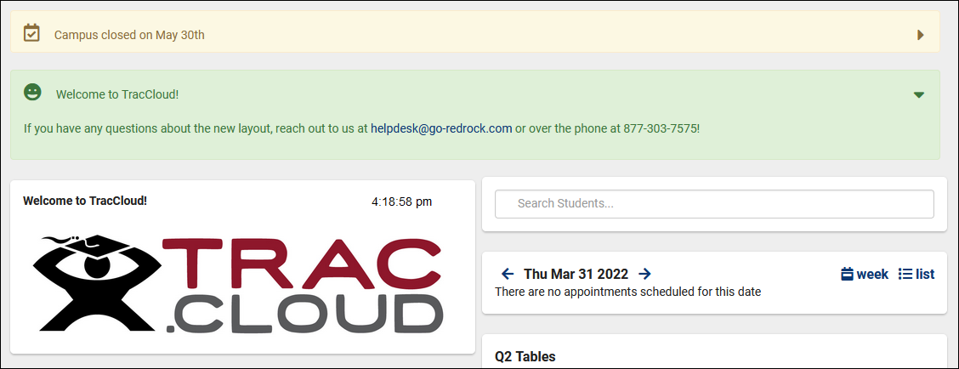
Personalizing traccloud
Using Twig and HTML to EDIT the appearance of your system
Bill Bennett

Slide 2
The system allows you to customize:
System Theme and Logo
Welcome Message
Announcements
Center Descriptions
Kiosk Messages
Appointment Display
Emails
Twig & HTML
And much more!

Slide 3
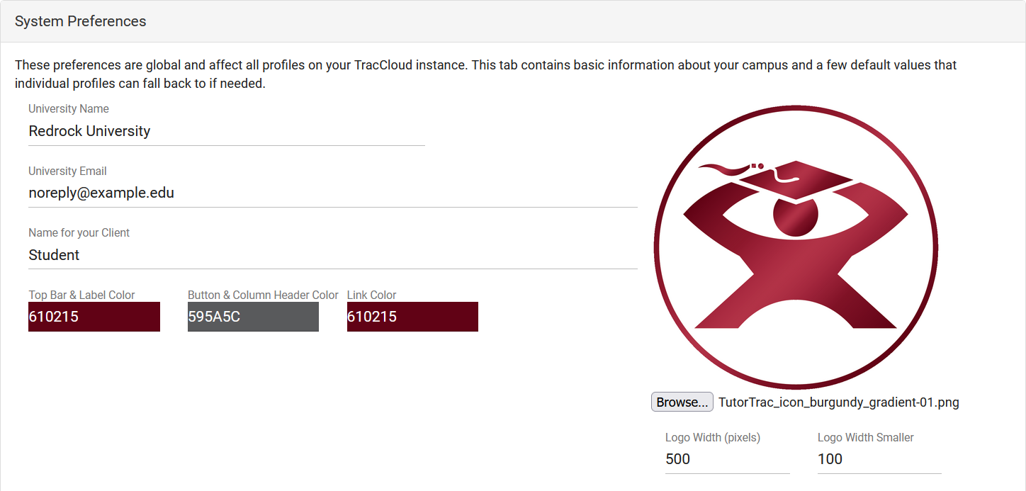
Logo and Theme
Match the visual Theme and Logo of your campus website!

Slide 4
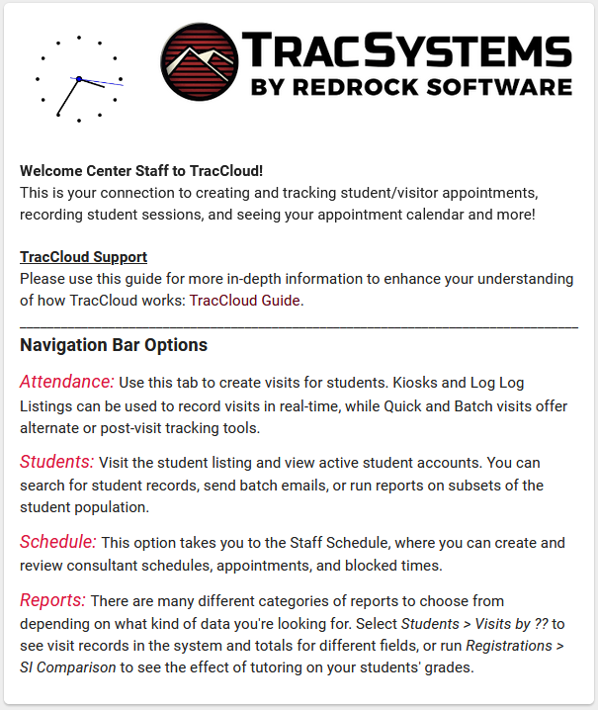
Welcome Messages and announcements
Welcome Messages are typically static, or updated infrequently. These messages can be unique for Students, Staff, and Faculty, and are displayed on the dashboard.
Announcements are typically dynamic, allowing you to configure messages that display for a certain amount of time, then expire at a set date. These messages can be unique for Students, Staff, Consultants, and Faculty. Multiple can be displayed at once.

Slide 5
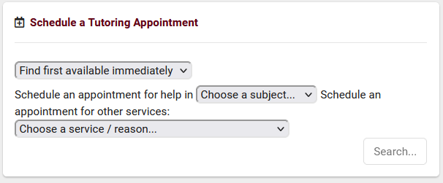
Customizing Widgets
TracCloud supports having multiple search availability widgets. Each can be customized to utilize different search functions and wording. Even the color of each title can be customized!

Slide 6
Appointment display
Further personalize your Trac System to make upcoming appointments streamlined for your use case.
Utilize Twig and HTML to change the look and contents of the field.
Ensure that only the necessary information is visible to students and staff.

Slide 7
Center descriptions
Center Descriptions allow students to select a center’s name during their availability search to access more information about the specific center offering the availability.
Profile Center Descriptions will act as a default description for any centers without their own custom description.

Slide 8
Badges
Search Availability Badges are used to add certain information of an availability. You may create as many badge rules as needed. Each availability that matches a badge rule will be marked with a badge icon and color. Additionally you may add an informative text description for the badge.
Profile Badges are used to identify the profile that a center is assigned to in the availability search.

Slide 9
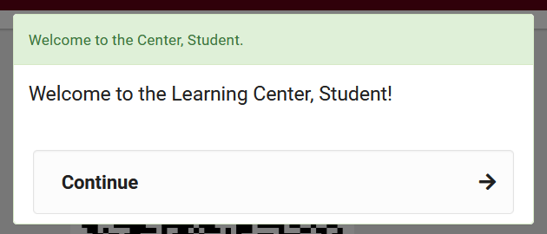
Welcome and goodbye message
HTML and Twig can be integrated for a customized student experience.
Messages can appear before, during, and after login; this provides several locations to welcome and inform students.

Slide 10
Custom views
Modify the displayed fields directly from a listing page, including custom fields.
Export the list contents as a CSV file.
You can modify the field columns on the Students, Visits, Registrations, and Faculty Listings.
For more information on views, be sure to check out Luis’s “Views” session!

Slide 11
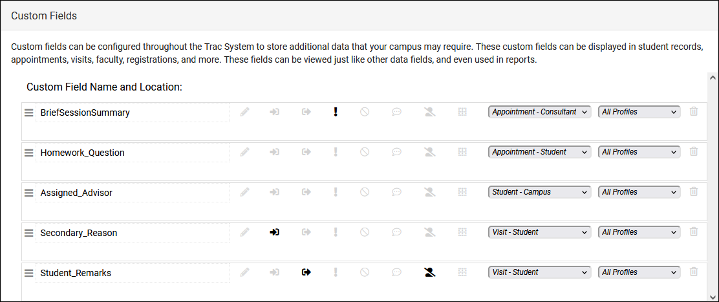
Custom Fields
Custom fields can be configured throughout TracCloud to store additional data that your campus may require. These custom fields can be displayed in student profiles, appointments, visits, faculty, registrations, and more.
Once this data is created, it can be actively used to get desired information during the booking and visit process.
Once this data is collected, you are able to include it in your reports!

Slide 12
html
HTML is the code that brings the internet to life! We can incorporate this coding language into many parts of the system, as an example, you can use the following HTML in messages, emails, etc.
What you enter
How it displays
<b>Hello!</b>
<i>Here’s a link:</i>
<a href=“https://www.go-redrock.com”>Clickable link</a>
<img src=“https://www.go-redrock.com/wp-content/uploads/2021/07/TutorTrac_icon_burgundy_gradient-01.png”>
Hello!
Here’s a link:
Clickable link

Slide 13
twig
Twig allows you to pull data from your system and display it in outgoing emails, welcome messages, and more throughout TracCloud.
WHAT YOU ENTER
HOW IT DISPLAYS
Hi {{Student.First_Name}}!
You have missed {{CalcMissedAppointments (Student.Sequence, Center.ProfileID)}} appointments this semester.
Hi Alex!
You have missed 3 appointments this semester. [uses System Pref date]

Slide 14
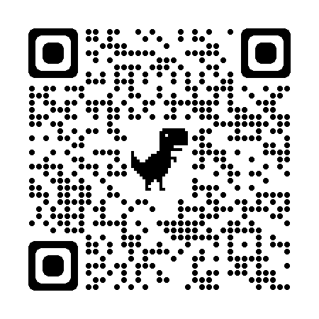
Additional twig
WHAT YOU ENTER
HOW IT DISPLAYS
{% if Appointment.Online == "1" %}This is an online appointment.{% endif %}
{% if Appointment.CustomData.cf_99 == "Blocked" %} You have been blocked from booking appointments. Reach out to[…] {% endif %}
This is an online appointment. [Only displays if the criteria is met.]
You have been blocked from booking appointments. Reach out to […][Only displays if the criteria is met.]
Be sure to check out our Wiki for the full list of Twig tags/syntax!

Slide 15
10% off new modules and/or profiles if purchased before 5/15/2024

