Slide 1
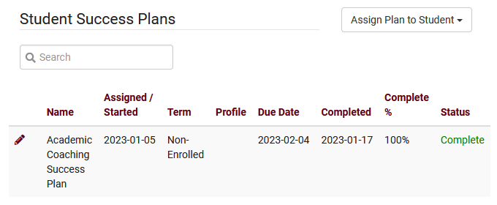
Success plans
Create and manage success plans for your students

Slide 2
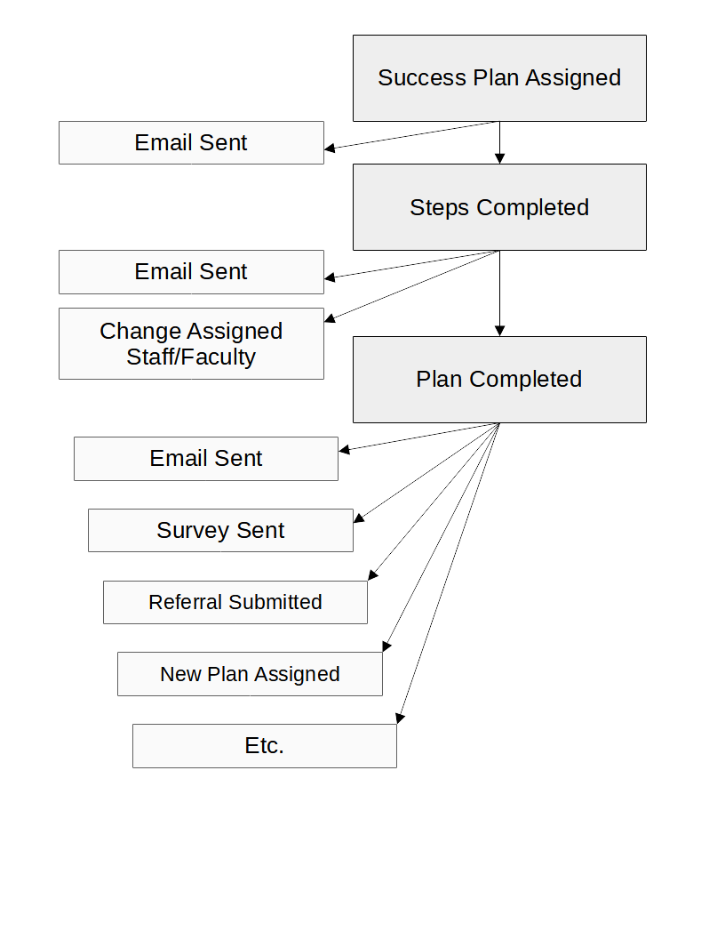
What are success plans?
Assign a Success Plan to the student and track their progress across your defined Steps.
Each Plan contains multiple Steps to complete. Visiting a center, responding to a survey, etc.
Once the Plan is completed, TracCloud can automatically initiate emails, surveys, referrals, and more. A second plan can also be assigned.

Slide 3
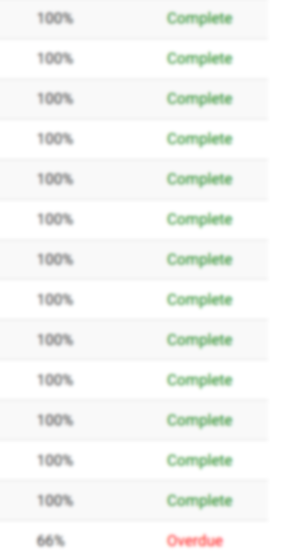
Creating a success plan
Define plan steps to track student progress, add follow-up emails, chain additional plans, and more.

Slide 4
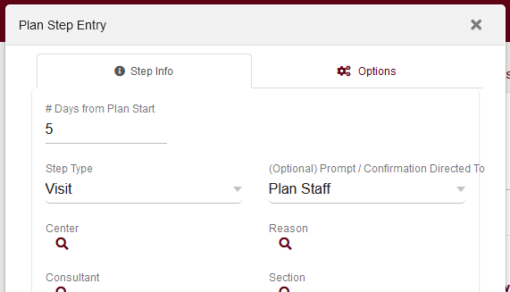
Steps
Each Step represents an action that the student must complete. TracCloud can automatically mark these Steps as Completed when that action takes place. The following records can be used as a basis for each step.
Visits
Survey Response
Document Upload
Task Completion
Resource Checkout
Notification Acknowledgement
Prompt Confirmation

Slide 5
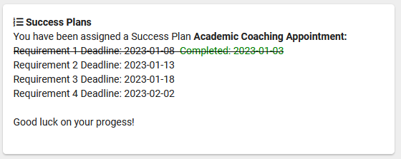
Dashboard display
Your Dashboard Display determines how Success Plan progress is shown to students. The header, footer, and the individual steps/lines can be independently modified to ensure your students are viewing relevant information.

Slide 6
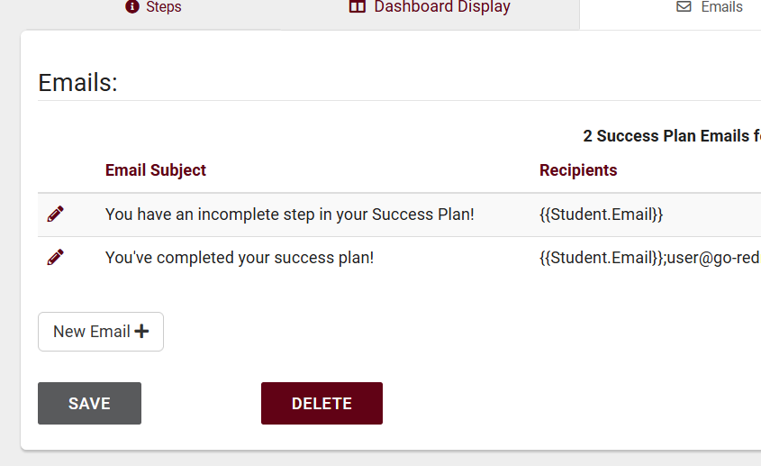
Emails
Emails can be automatically sent to students to update them on their Plan progress. Each email can further modify the Plan itself by changing the linked staff or faculty, or even initiating new Surveys or Referrals with Twig. Individual Steps and the overall Plan can be assigned emails independently of each other.
Plan/Step Started This email is sent when a Plan is first assigned, or when a new Step is available to begin.
Plan/Step Reminder Up to 3 reminder emails can be sent for the overall Plan, and an additional 3 emails can be sent for each Step.
Plan/Step Complete This email is sent when a Step or the overall Plan is completed.

Slide 7
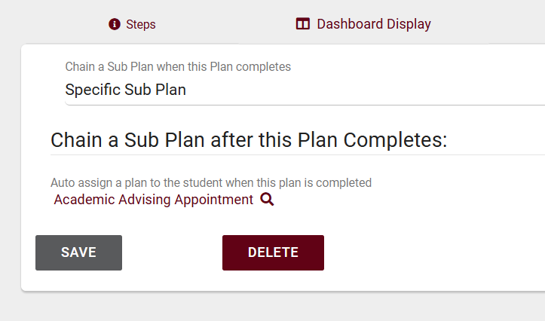
Chaining sub-plans
Upon Plan completion, TracCloud can initiate other processes, including assigning an additional Succuss Plan to the student.
Specific Sub Plan Choose a Plan that will automatically be assigned upon Plan completion.
Conditional Sub Plan Use Twig to add logic determining if a Plan needs to be created, and which Plan should be used.

Slide 8
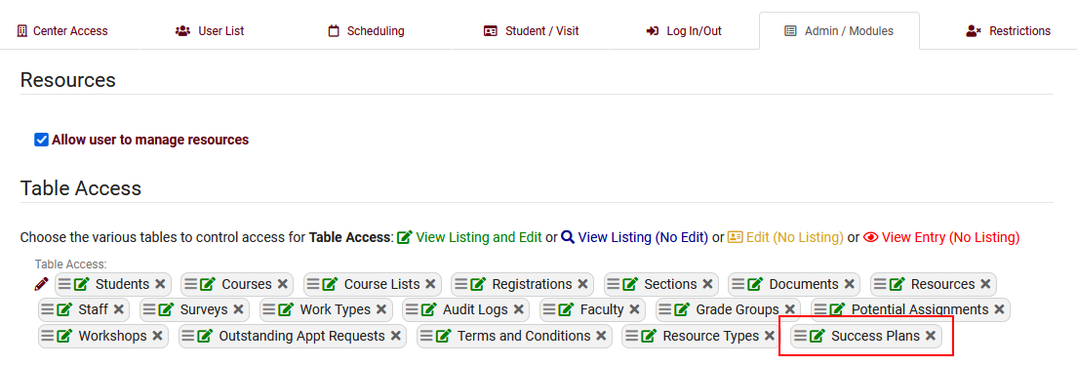
Group permissions
To provide access to your users, you will need to assign Success Plans to their Permission Group’s Table Access. This is found under the Admin / Modules tab.

Slide 9
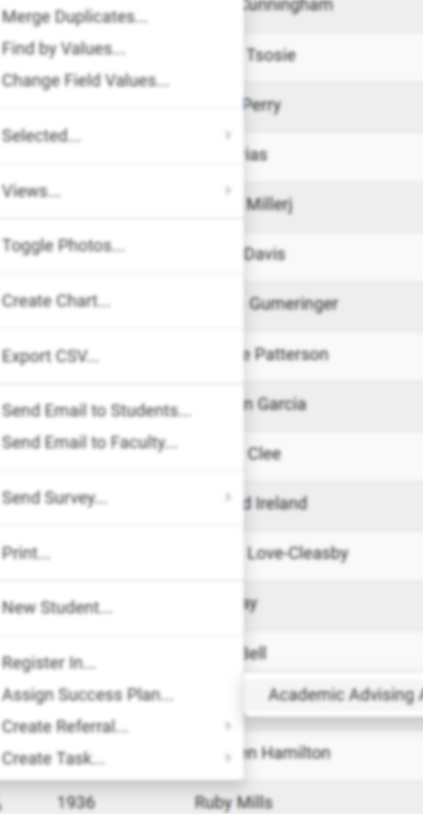
Assigning plans to students
Plans can be assigned to students individually or in a batch

Slide 10
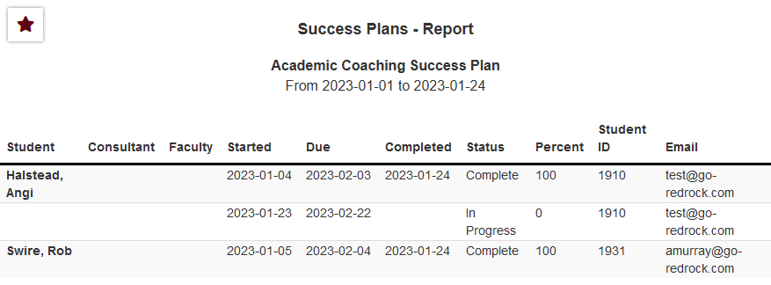
Success Plans report
The Success Plans report can be used to show information about current and past Plans and their overall completion. This report can be sorted by student or date (start, due, completion).

Slide 11
Success plans discount
We like to reward our conference attendees! For those that attend the 2023 conference, we are offering a $600 discount on our new Student Success Module and 10% off all other modules and/or profiles for TracCloud if a quote is requested at the conference and purchase is made by 4/30/2023.
Please see Laura or email her at laura@go-redrock.com to request a quote!

