Slide 1
TracCloud Terminology

Slide 2
TracCloud Terminology
Understanding terminology is important.
With the CLOUD system it is just the same! Come learn about terminology so you may have the best experience with the system.
This will also aid when getting help from the Redrock team. Get the quickest response to the questions you might have with us via phone, helpdesk ticket or a training call.

Slide 3
TracCloud Instance
License = Your system with custom URL settings and configurations - comes with one profile. License can be used as a production site or a test instance.
Profile = An additional configuration base where you can manage rules, center reasons and subjects separately from another profile. Can be shared on the same license.
Center = Centers are used as physical or online locations where visit and appointment data can be collected. Centers are linked to a profile, which are linked to a license.

Slide 4
Accounts In System
User Level
(limited access to most access)
Staff – Most hires or work accounts for your staff
(tutors, consultants, advisors, coaches, etc)
Profile Admin – Second in Command, needs access to adjust centers, create reasons, adjust email templets in profile (and ONLY profile adjustments)
SysAdmin – FULL Access user who has access to front and back end settings for Profile AND Global settings that would effect the whole license.

Slide 5
Accounts In System
Other Accounts
(limited access to most access based on group permissions)
Student – Client coming in for services
Faculty – Instructor of course
Staff - A user account that has access based off group permissions (log students in for visits, book appointments, run reports, etc).
Staff Consultant – A user account that can be given the ability to create their own availability for appointment times or drop in slots. Normally used for Tutors and Advisors.

Slide 6
Navigating The TracSystem
Dashboard
Homepage for all users.
Widget
Modules or features that display. on the Dashboard.
Hamburger Icon
Available Next to all Listings.
Click to open Options.
Navigation Search
Available in all Listings.
Varies Searches can be performed.
Listing
List of related records.

Slide 7
Visits/Attendance
A Visit represents that the student was present at your center at X time, for Y subject, Z reason, etc.
Work Visits
Consultants sign in for work to track hours and pay rates.
Log Listing
Staff view to see students who are currently logged in.
Kiosk
Student-facing computer, where students are logging themselves in/out.
Visit Queue List
Student-facing queue that displays students that are waiting to be seen..
Visits are recorded when a student comes into the center (physically or virtually). Visits are also used to identify/mark if a student attended a appointment that was scheduled.

Slide 8
Quick and Batch Visits
Quick Visits are used to record a visit session for one individual student.
This will capture the center, time in and time out, subject, reason and staff member for that session.
Batch Visits are visit sessions that are recorded for a group of individual at one time.
This is used for workshop settings or if attendance is needed to be taken outside of a classroom setting. It will capture everything a quick visit can do, as well as notes for that session, and create a separate visit record for those 15 students at once.

Slide 9
Availabilities
Availabilities are Pre Determined Time slot for each staff member letting the students know when they are available to meet.
Availability Types: One on One, Group, and Drop in availabilities.
Availabilities may be seen by Staff, User Accounts and Students based off permissions.

Slide 10
Appointments
A appointment represents a scheduled time that has been booked in advanced for a specific time, consultant, for a course specific subject and reason.
1-on-1
Student will work independently with an individual staff member.
Group Appointment
Staff member works with multiple students of the same (or different section) in one appointment.
Drop-In
Students can see the drop in time a staff member is available and join a session between the listed time span.
All appointment availabilities can be created to reflect in physical location or the virtual meeting room. Once the results are searched they can see if it is in person, online or optional (person booking can decide!)

Slide 11
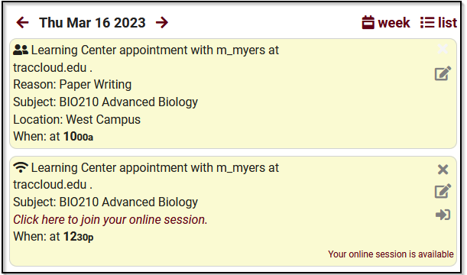
Appointment Display
Gives details on an appointment on the dashboard (both student and staff). Twig coding is used to narrow down the details that are displayed to the induvial. Such as Center, Subject, Reason, Location, etc.
Students with a online session will be able to join the virtual meeting room from this widget.

Slide 12
Visits VS Appointments
Visits
Appointments
Visits are used to keep track of who is coming in and out of your center(s).
Visits are used for recording drop ins, independent study, appointments and more.
Visit time can be different from appointment duration.
Visit can be created without an appointment.
Is a pre an arranged time to meet someone at a particular time and place.
Appointments use Status to keep track if they are attended, canceled, rescheduled, etc.
Appointments can be marked as attended manually. If there is a visit created for the appointment, it will be marked as attended manually overnight.

Slide 13
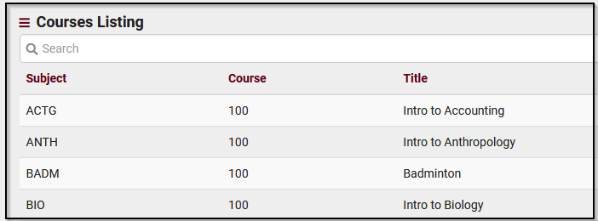
Course
Course are what cover an individual subject. Courses have a fixed set of criteria. Courses are linked to a section that displays as a registration for students.
Courses can be sent over in a registration file and be imported into the system. Non-Enrolled Courses can be created to document assistance when needed, if registrations are missing or not in a enrolled course – such as a “workshop” or “other” option.

Slide 14
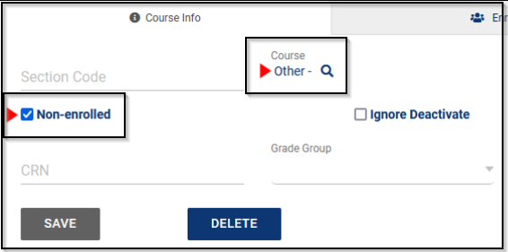
Section
A course may be taught in one or more sections/classes, depending on enrollment in the course. Sections are used to identify individual classes.
One of our campuses on TracCloud use abbreviation for their locations, to filter out what sections are available to that subset of students.
Sections are always linked to a course!

Slide 15
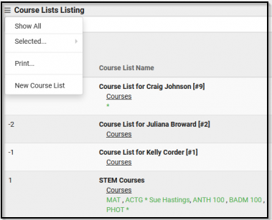
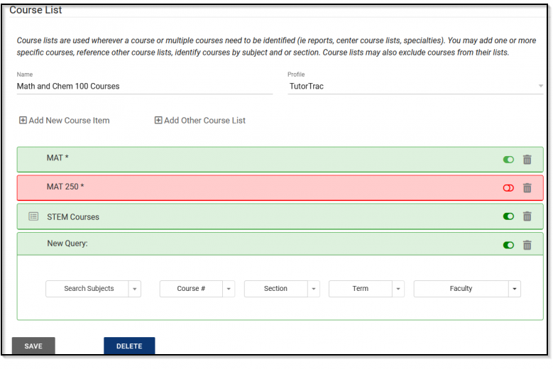
Course List
Course Lists act as assigned sections or specialties in TracCloud, allowing one to easily determine which courses a staff member can assist with, and which courses are available in each center.

Slide 16
Registrations
Registrations are the official record of the students enrolled courses. The system will identify in the student record if the course is active (green check box) or if they are inactive/withdrawn.

Slide 17
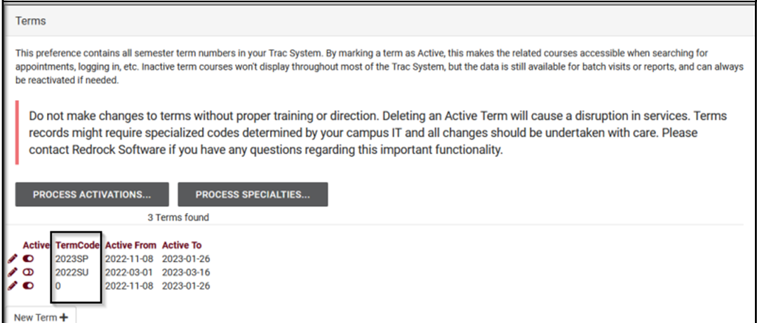
Terms
Term is a preference that contains all the semesters that the TracSystem will see as active and inactive when searching for an appointment or a reason for a visit.

