Slide 1
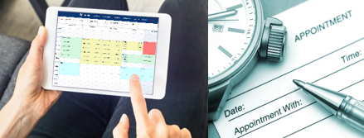
Reports, Data & Scheduling
Q&A for TracCloud
With Luis

Slide 2
What Are Your Questions?

Slide 3
Reports, Visits & Data
FAQ- How can I run Reports on a specific visit information?
FAQ- How can I run reports on specific populations of students?
FAQ- How do I know if my Staff have access to reports?

Slide 4
Appointment Scheduling
FAQ- How can I constrain a list of students to a specific Center for scheduling?
FAQ- How are students visits linked to their appointments?
FAQ-How can an appointment be cancelled and moved to a new tutor or new time?

Slide 5
Reports
FAQ- How can I Save a Favorite Report in TracCloud?
FAQ- How can Reports be automated?
FAQ-Are there any Reports that can be exported from TracCloud?

Slide 6
Appointment Scheduling
Which Centers can my Students and Staff book appointments in?
FAQ-Are there any Availabilities Reports?
FAQ- Which Report is best to pull top get detailed Appointment information?

Slide 7
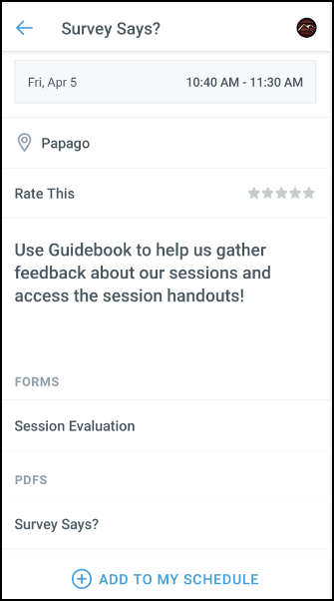
GUIDEBOOK: Session Evaluation & Handouts
After the session you attended to fill out the Session Evaluation:
Click on Session Schedule then the Session Title
Toward the bottom, click on Session Evaluation
Fill the out the Survey and click Submit
Want the handout for the session you just attended:
Click on Session Schedule then the Session Title
Toward the bottom, in PDFS click on the guide you want to download.

