Slide 1
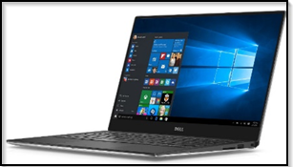
Trac(k) Resources
Lending Library At Your Fingertips.

Slide 2
What are Resources?
Resources are items that may be checked in and out of your center(s).
Resources could be materials such as textbooks, calculators, laptops, or anything else of value that you may lend out to students.
Resource history and activity is recorded and can be reported on.

Slide 3
Overview
Creating Resources and “Type” Preferences.
Creating Resource Email
Searching Resources.
Checking Resources In and Out.
Report on Resources.

Slide 4
Resource Types

Slide 5
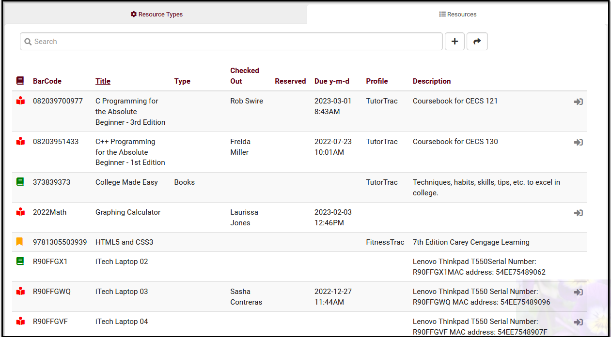
Resource Key
Inactive
Active
Reserved
Checked Out

Slide 6
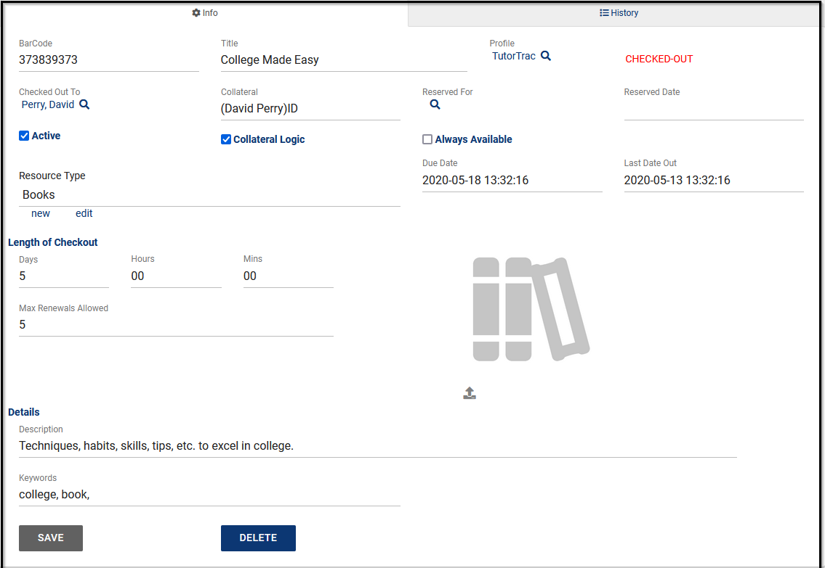
Creating a Resource
BarCode is the unique identifier for this item.
Title is the name of this resource.
Profile is the linked Profile for this resource
Checked Out To shows which student currently has this item checked out (if applicable).
Collateral represents an item to be collected when this resource is checked out.
Collateral Logic enables collateral functionality if checked.
Reserved For shows who currently has this resource reserved.
Always Available indicates that this resource doesn't need to be individually checked out or reserved (Example, towels for fitness center).
Reserved Date, Last Date Out, and Due Date display the exact times of reservations, checkouts, and when the resource is due to be returned.
Resource Type allows you to categorize this resource into a type for reporting purposes.
Length of Checkout determines how long an item can be checked out.
Max Renewals Allowed determines how many times a checkout can be renewed.
Description is an internal description of this particular resource.
Keywords are the related words for this resource to be searched by.

Slide 7
Resource Email
Other > Other Options > Profile > Email > Resource Checkout Email
Personalize Overdue Email and Resource Confirmation Email using Twig Coding.

Slide 8
Permission Groups
Other > Other Options > Groups > [Your Group] > Log In/Out
Allow user to log resources in and out provides users in this group the ability to record resource usage.
Allow user to view what resource the student has logged out provides users in this group the ability to view a student's currently logged out item.

Slide 9
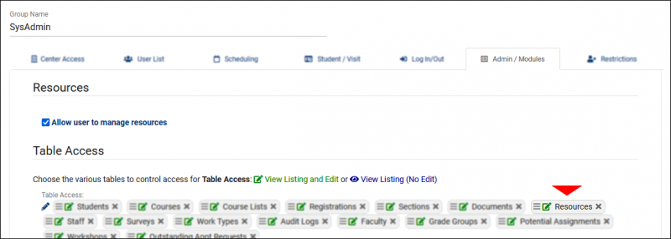
Permission Groups
Other > Other Options > Groups > [Your Group] > Admin/Modules
Allow user to manage resources provides the ability to modify resource records.
Table Access provides access to the Other > Listings > Resources view of resources.

Slide 10
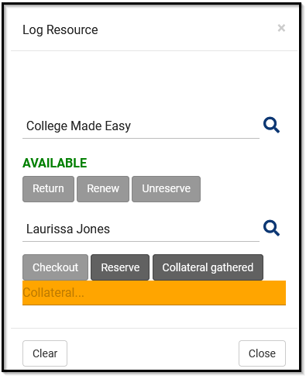
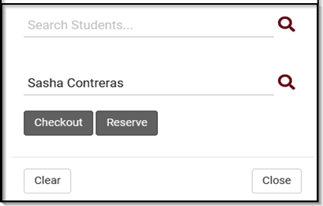
Log Resource
Other > Log Resource
Search an item by keywords to get a filtered list of resource options that are available to check out.
Using a student ID, identify the student that is getting the item checked out to them (or reserve item).
If item has collateral: A student may need to leave their Student ID Card to check out an item, which they will get back upon returning the item.
Resource Items can now to checked out to staff members!

Slide 11
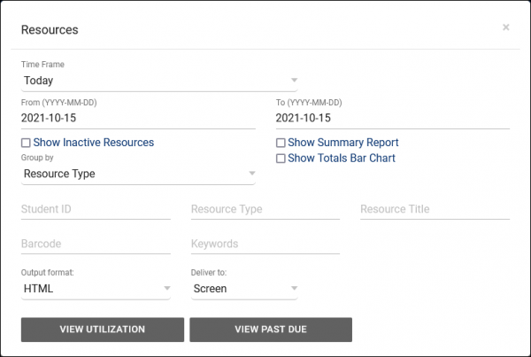
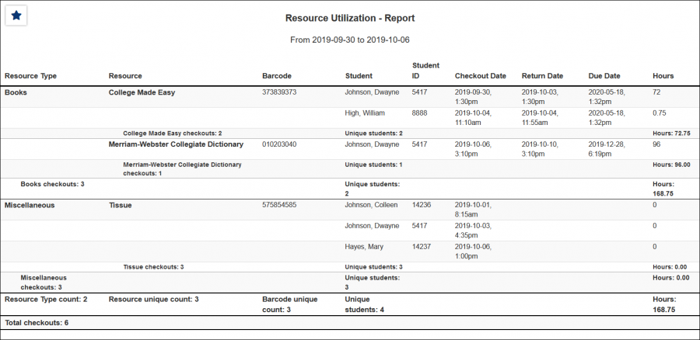
Resource Reports
Other > Log Resource
This report shows the students who have checked out a particular resource, the checkout date and time, as well as total hours. This can either be run on overall Utilization, or specifically on Past Due resources.
Reports has the option for CSV export (Raw data) or with grouping totals.

