Slide 1
Checking In…?
Visit Utilization & Data analysis
Luis Frias
Redrock Software

Slide 2
Topics We Will Cover Today
Creating Visits -Quick Visit -Batch Visits -Work Visits
Kiosk Options -Kiosk -Dynamic Kiosk Managing visits -Attendance Listing -Quick Searches -Power search
Visit Permissions & Settings
-Group Permissions (Center Access) -Group Access (Students/Visit) -Log List Customization
Reports -Visits By? -Usage Snapshot -Students Visits Cleanup Data

Slide 3
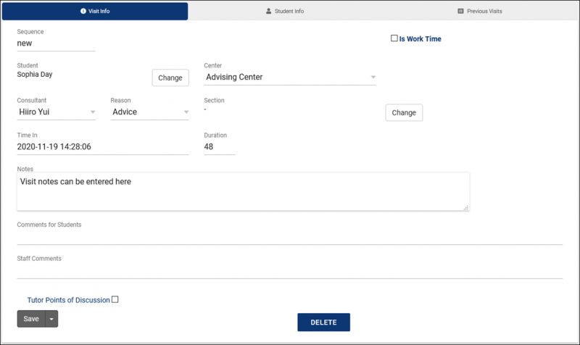
Creating Quick Visits
Quick Visits allow you to create visits after the fact.

Slide 4
Creating Batch Visits
Allows You to Record a Visits for a Group, Workshop or S.I. Session
Batch Entry - Batch Entry allows you to enter basic visit information once (time, tutor, subject), then you can create visits and write notes for one student at a time. You can also create visits for several students at once with the “SELECTED” button, which will use your student listing search results.
S.I. Batch entry - SI Batch Entry provides a list of students enrolled in the course you selected. You can simply highlight the students you want to create the new visit for by clicking on their names. Data is filtered by Students with or without previous visits.
Batch Scan - Batch Scan allows you to create visits for many students at once from a text file. Simply copy/paste the contents of the file into the “Scanned Data” field, set the Scan Type to ID, Sequence, Email, or Other ID, and type in any notes you want to leave. A visit record will be created for each student in the file.

Slide 5
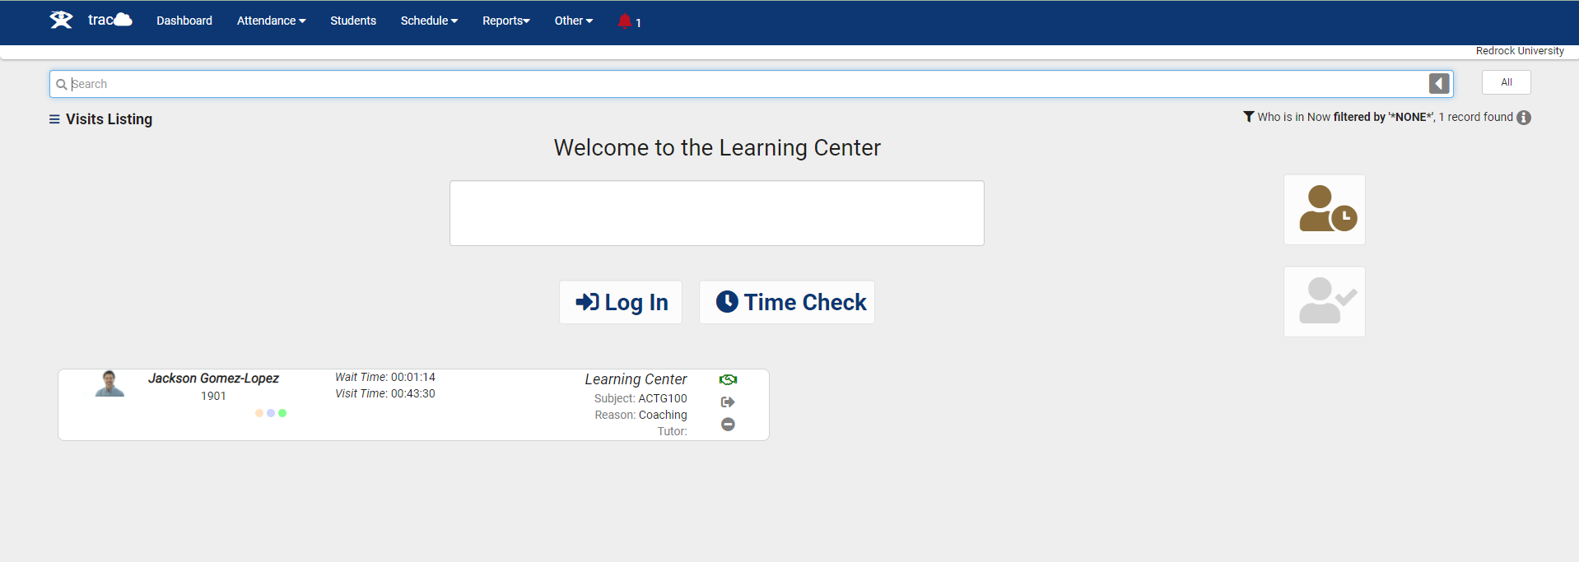
Log Listing
Digital Sign-in Sheet to Quickly Identify Who is Logged in
The Log Listing and Kiosk views of TracCloud can be easily customized, determining what data shows up and how it displays.

Slide 6
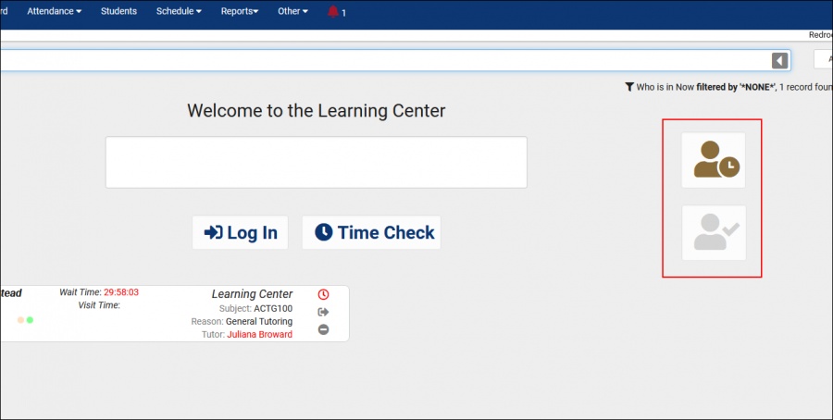
Work visit listing
If your Profile Preferences allow it, consultants can login for work from a Kiosk or on the Log Listing by clicking the first highlighted icon below. This will prompt them to choose a center and work reason for their visit. The second icon opens a window that displays currently logged in consultants.

Slide 7
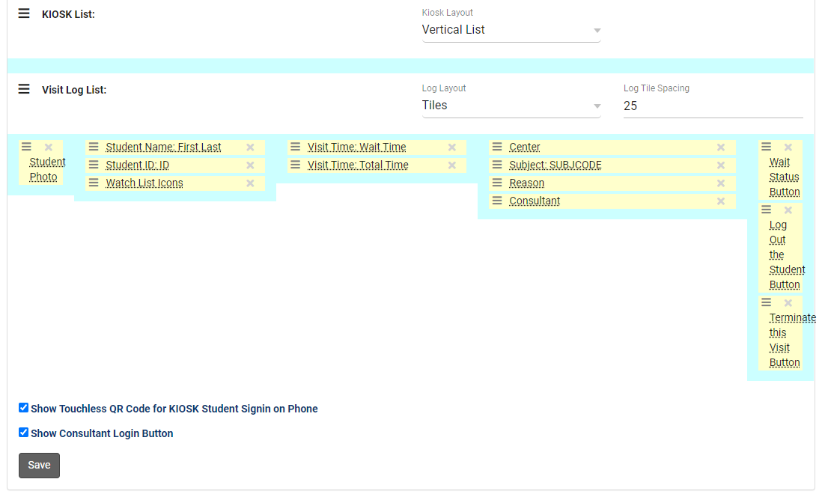
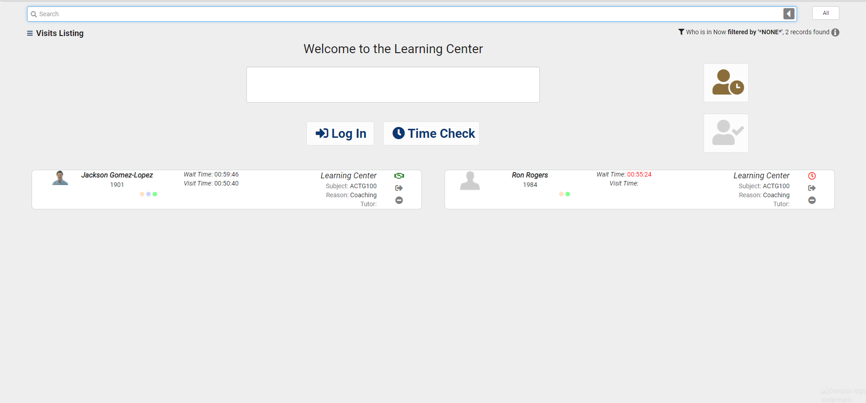
Log Listing Display Sample
The Log Listing and Kiosk views of TracCloud can be easily customized, determining what data shows up and how it displays.

Slide 8
Waiting List options
Will Display the Student Name with a “Waiting” timer
When ready to meet with a student, the consultant can click on the clock symbol for that student and change the status to started
Queue List can be activated for students to see on a screen who is next in line to meet with a consultants

Slide 9
What is a Kiosk?
Provides Users with a Sign-In Station that can run Independently
Students Sign in When They Arrive and Out When They Leave
The Kiosk Station Does Not Need to Be Staffed or Actively Overseen by a Staff Member
Since it is Primarily Used by Students, Access is Very Restricted

Slide 10
Kiosk Options
Custom KIOSK Options Preset: Linked Subcenter, Location and Consultants section and Reasons.
Custom Questions Can be created and customized for each profile and can be displayed when a student logs in or out for their Visit
TimeCheck Enabling the Time check feature allows for students to check to see how much time they have spent in a center over a week or semester time frame for each subject as well as a total time. Students can also keep Track of required times as well.

Slide 11
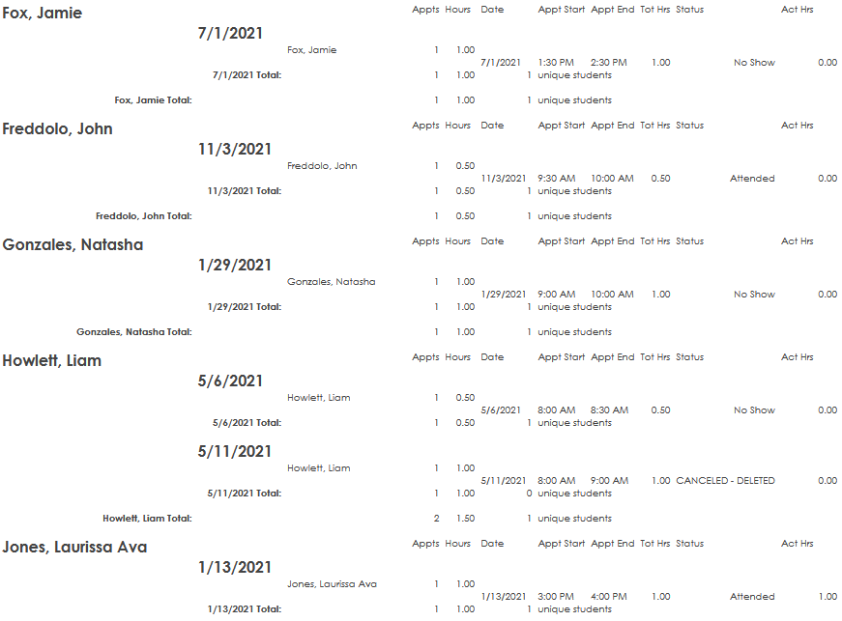
Reports
Report Chooser:
-Visits By? -Usage Snapshot -Students Visits Cleanup Data

