Slide 1
A Year in the trenches with TracCloud
Mark A. Woolwine
Assistant Director, Learning Resources
Resources for Academic Achievement (REACH)
March 31, 2023

Slide 2
Overview
Play a little game
About the University of Louisville
About REACH
Transition
Training
Automation & Email
Reports

Slide 3
About the University of Louisville
Located in Louisville, KY
3 Campuses
Belknap – Primary
Health Sciences – Medical/Dental
Shelbyhurst- Some professional programs
Undergraduate student enrollment: 15,830 (Fall 2021)
Freshman - 3,345
Sophomore - 2,717
Junior - 3,341
Senior - 4,369

Slide 4
About REACH
REACH is UofL’s free primary academic support program for all undergraduate students
15 Professional Staff
12 Graduate Assistants
200+ Student Staff- tutors, academic coaches, PAL Leaders

Slide 5
About REACH
10 Distinct sub-centers housed within REACH
Learning Resource Center
Math Resource Center
Computer Resource Center
Academic & Leadership Center
Peer Assisted Learning
Structured Learning Assistance
Academic Coaching
Emporium Math Lab
GEN 105- Supplemental Reading
Hackademic Series Workshops
REACH is UofL’s free primary academic support program for all undergraduate students

Slide 6
Student Usage Fall 2022
Center | Students | Visits | Hours
Academic Coaching | 172 | 233 | 121.08
Computer Resource Center | 196 | 406 | 492.48
Emporium Math Lab | 1005 | 17563 | 17817.24
GEN-105 | 214 | 3141 | 3137.83
Hackademic Series Workshops | 905 | 1302 | 1256.5
Learning Resource Center | 357 | 1978 | 2134.84
Math Resource Center | 792 | 2993 | 3997.15
Peer Assisted Learning | 854 | 5542 | 7321.31
Structured Learning Assistance | 380 | 1597 | 1813.8
Academic & Leadership Center | 115 | 245 | 315.63
Center Totals: | 3098 | 35000 | 38407.86

Slide 7
Student Usage Spring 2023- thru today
Center | Students | Visits | Hours
Academic Coaching | 68 | 88 | 44.75
Computer Resource Center | 218 | 415 | 440.65
Emporium Math Lab | 696 | 9005 | 9320.96
GEN-105 | 96 | 986 | 818.38
Hackademic Series | 14 | 14 | 21
Learning Resource Center | 240 | 1186 | 1203.31
Math Resource Center | 542 | 2245 | 2806.94
Peer Assisted Learning | 604 | 2889 | 4002.41
Structured Learning Assistance | 216 | 762 | 1001.1
Academic & Leadership Center | 105 | 392 | 477.53
Center Totals: | 2016 | 17982 | 20137.03

Slide 8
Transition

Slide 9
REACH’s HISTORY with TRACSYSTEMS SOFTWARE
Started using TutorTrac in 2007
TutorTrac 4.0
2010
TracCloud
Summer 2022

Slide 10
What helped us in our transition?
We completely overhauled our import script and the import file about 8 months before our transition.
Met regularly with our campus staff to review what information need to be transitioned over to TracCloud from 4.0
Reviewed all visit reasons and consolidated reasons down to the essential reasons needed
Met regularly for at least a month with Luis from Redrock to learn the ins and outs of the system and completed all nightly homework assigned to us
Migrated between Spring & Summer terms

Slide 11
What helped us in our transition?
Determining the roles that professional staff, graduate student assistants, tutors, peer leaders, and academic coaches would have in the system
Two System Admins
Professional staff & graduate student assistants
Profile Admins
Admins over their sub-centers
Tutors, peer leaders, academic coaches
Staff profiles assigned to their sub-centers

Slide 12
Training

Slide 13
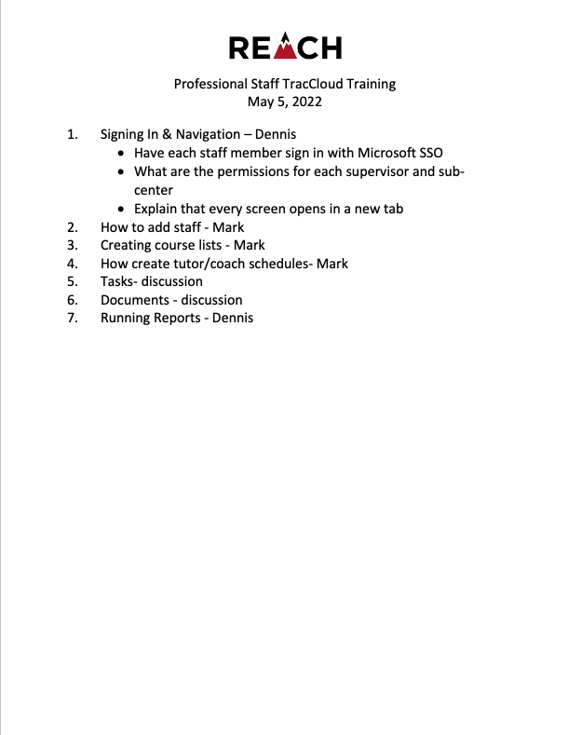
Training
Professional Staff training on May 5, 2022
Structured training around the layout of the dashboard, adding staff, creating course lists, reports
Graduate Student Assistant Training- August 3, 2022
Tutor/Peer Leader/Coach Training – August 15 & 16, 2022
This training was presented by center supervisors and covered what they felt their staff needed to know.

Slide 14
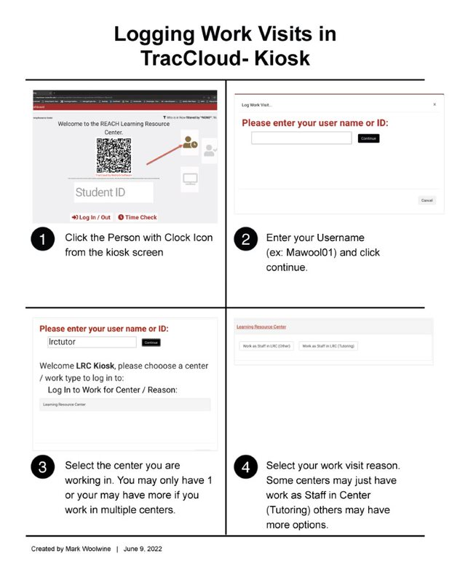
Other Training Resources
Created “How-To” sheets for main tasks required of the tutors, peer leaders, and academic coaches
Topics included:
Logging Work Visits in TracCloud- Kiosk
Logging Work Visits for Online Tutoring
Viewing Your Weekly Schedule
Viewing Appointment Details and Adding Notes

Slide 15
Other training
Modules
In the process of building interactive modules that will be available 24/7 to all staff on various TracCloud topics.
Built using Articulate Rise 360
Will be added to the university LMS organization for REACH Staff (Blackboard)
Videos
Created videos for students that are posted on our website on how to sign in, search for availabilities, etc.
1st Module to focus on signing, understanding schedule, adding visit notes
Month training on features for Professional Staff

Slide 16
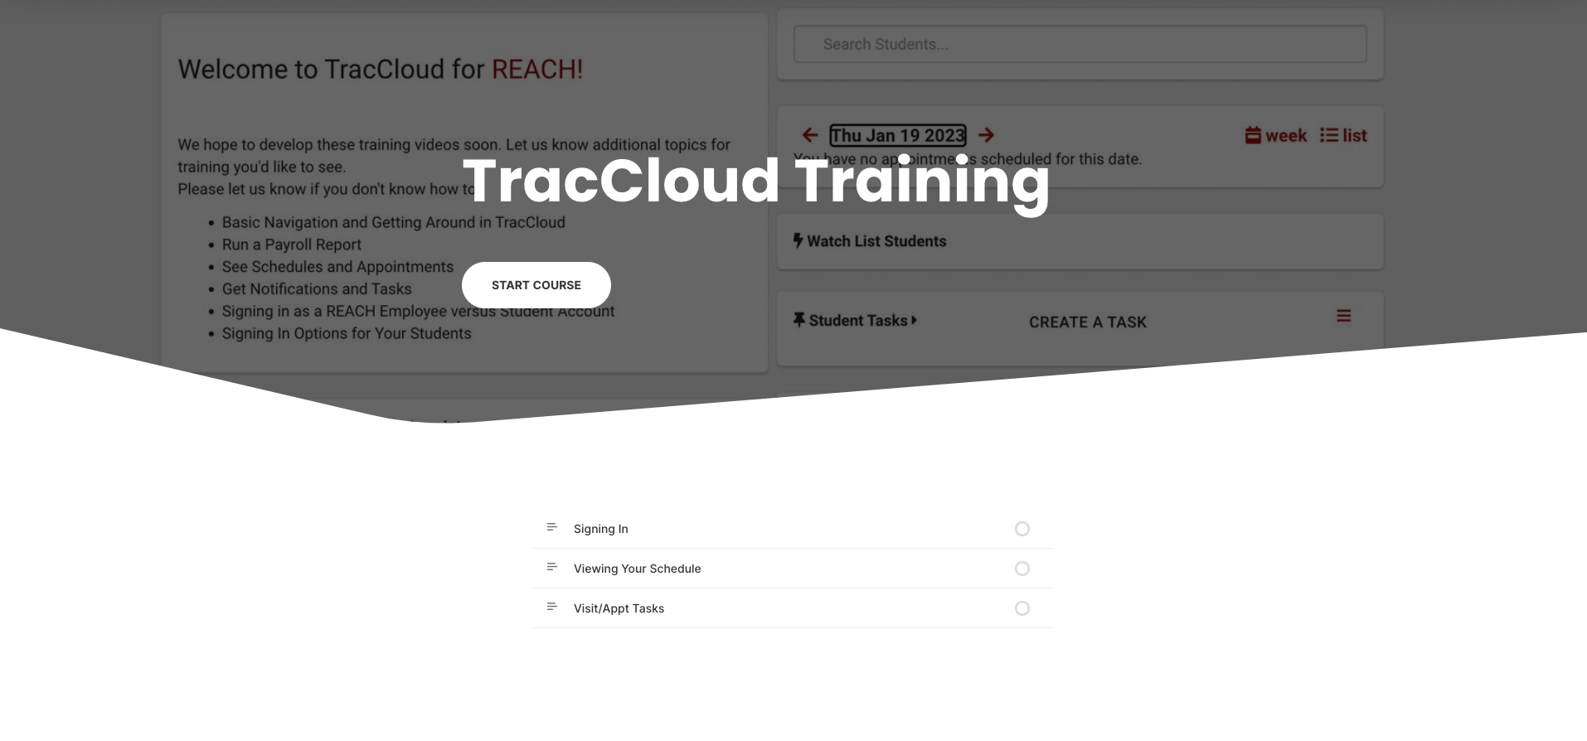
Articulate Rise 360 Training Module

Slide 17
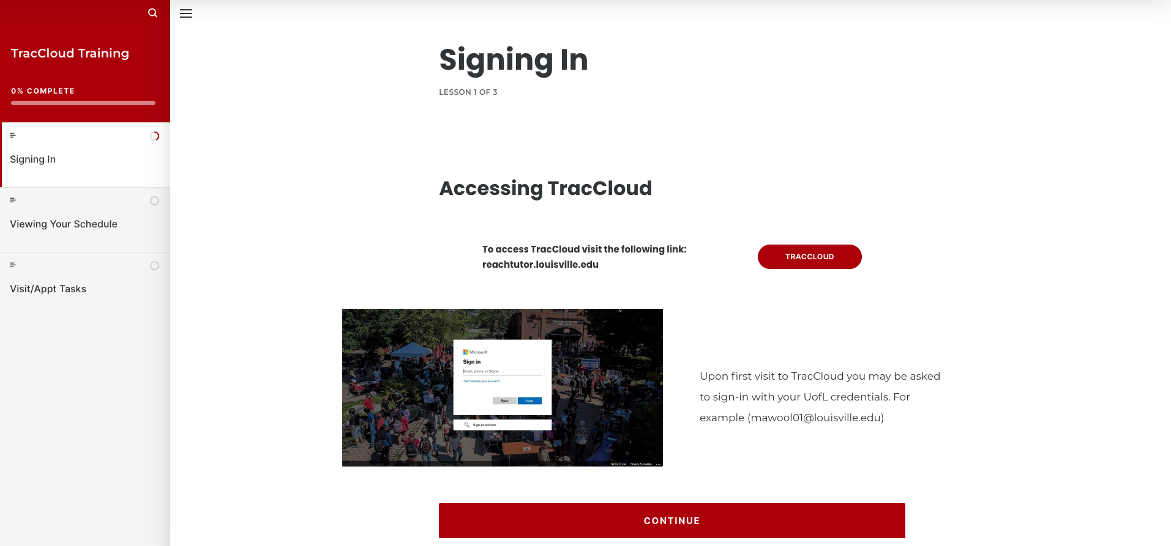
Articulate Rise 360 Training Module

Slide 18
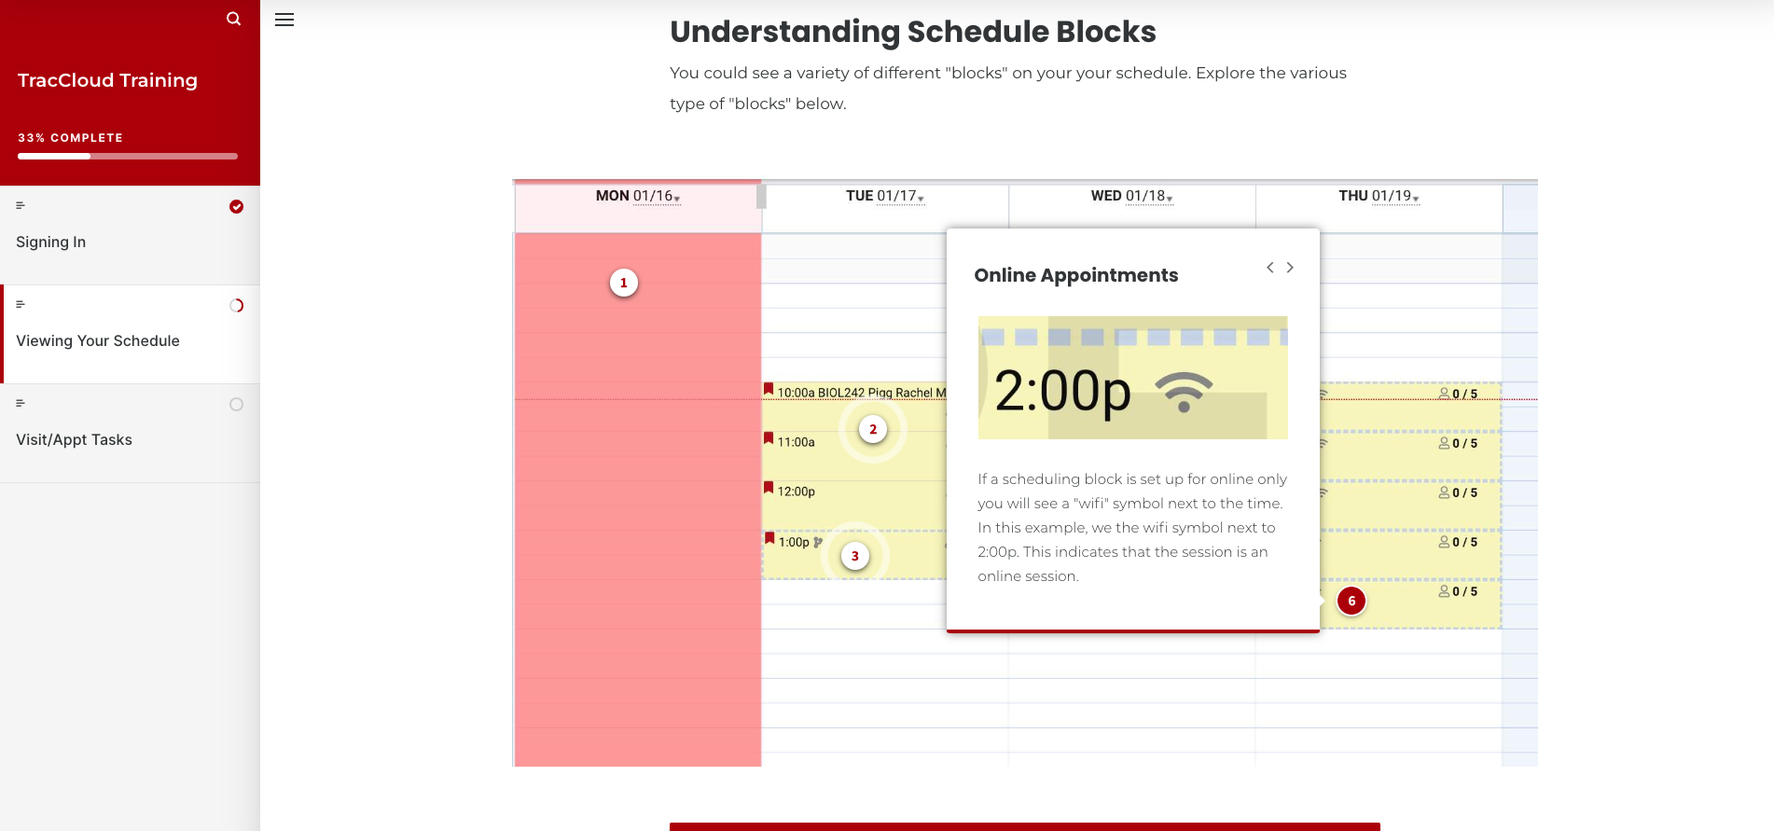
Articulate Rise 360 Training Module

Slide 19
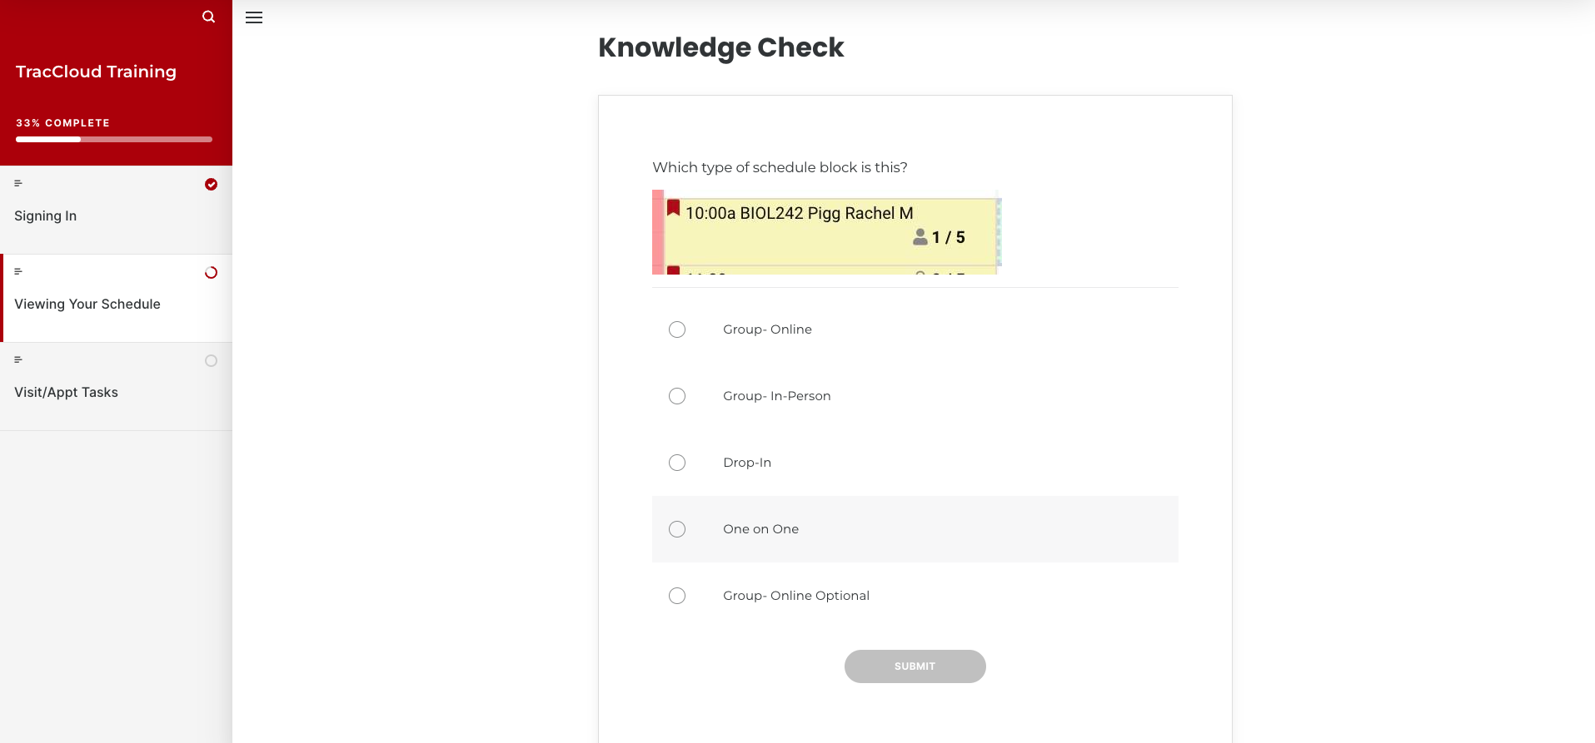
Articulate Rise 360 Training Module

Slide 20
Automation & Email

Slide 21
TracCloud automations & emails
Custom confirmations, reminders, cancelations for each sub-center
Email templates for sending messages to students
Automating reports to campus partners

Slide 22
Custom Email Confirmations, Reminders, Cancelations Per Sub Center
Dear {{Student.First_Name}} {{Student.Last_Name}};
<br>
<br>{% if Center.Name == "Ekstrom Tutoring Center" %}
This is a confirmation that you have been scheduled for the following appointment(s):
<br>
<br><b>Tutor:</b> {{Consultant.FirstLast}}
<br><b>Subject:</b> {{Course.SubjectCourse}}
<br><b>Date:</b> {{Appointment.StartDate}}
<br><b>Time:</b> {{Appointment.StartTime}} - {{Appointment.EndTime}}
<br><b>Location:</b> {{Center.Name}} - {{Appointment.Location}}
<br>
<br>For assistance with REACH Tutoring appointments in the Ekstrom Tutoring Center, please contact Dennis Keibler @ dennisk@louisville.edu or call 502-852-8096
{% elseif Center.Name == "Speed School" %}
This is a confirmation that you have been scheduled for the following appointment(s):
<br>
<br><b>Tutor:</b> {{Consultant.FirstLast}}
<br><b>Subject:</b> {{Course.SubjectCourse}}
<br><b>Date:</b> {{Appointment.StartDate}}
<br><b>Time:</b> {{Appointment.StartTime}} - {{Appointment.EndTime}}
<br><b>Location:</b> {{Center.Name}} - {{Appointment.Location}}
<br>
<br>For assistance with REACH Tutoring appointments in Speed School, please contact Dennis Keibler @ dennisk@louisville.edu or call 502-852-8096
Learn the basics of Twig
Redrock has great resources on their online wiki and Twig and the various fields that you can use within the system.

Slide 23
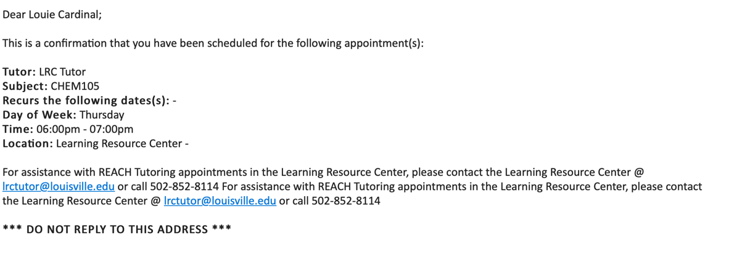
Out of the box emails

Slide 24
Custom email templates with HTML

Slide 25
Automating reports can speed up daily tasks
Automating reports
Key fields to complete when automating a report
Deliver to: should be set to Email in this case.
Email Address(es) is where you'll add your recipients' email addresses. Multiple addresses can be entered, delimited by a semicolon.
Enable Automation will enable automation and make the following options available.
Message to include in the report email will add in some custom messaging to your emailed report.
Automated report frequency. Do you want this report to run daily, weekly, monthly, or once on a specific date?
Time will determine the time that this report will run on your scheduled frequency.
Overwrite This Favorite Report will overwrite your existing report settings with your new automation rules.
Steps to automate a report
Save report as a favorite
Edit the favorite
Enable automation at bottom

Slide 26
Examples of when an automated report may be helpful
Automating reports
Professor wants a list of students who attended sessions each week
Other campus partner wants a list of students who attended workshop
Director wants a usage report sent weekly to the sub-center managers

Slide 27
How are we using templates?
Email templates
Email templates allow you to configure pre-written emails that can be easily accessed and modified when needed. These could be used for standard messages that would be frequently sent to students.
Course advertisements
Language Conversation Tables
The power of templates?
{#?FIELD#}
This allows you to prompt a piece of text to be replaced when the template is used. As an example, let’s say your campus closes on certain days each month, but it’s not consistent enough to include in the template. In this case, let’s use a tag like this: {#?ClosureDates#}

Slide 28
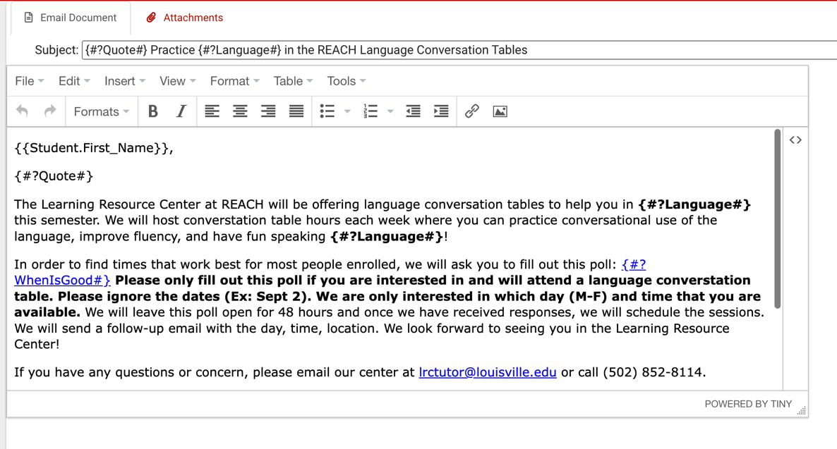
Examples
Email templates
Email templates allow you to configure pre-written emails that can be easily accessed and modified when needed. These could be used for standard messages that would be frequently sent to students.

Slide 29
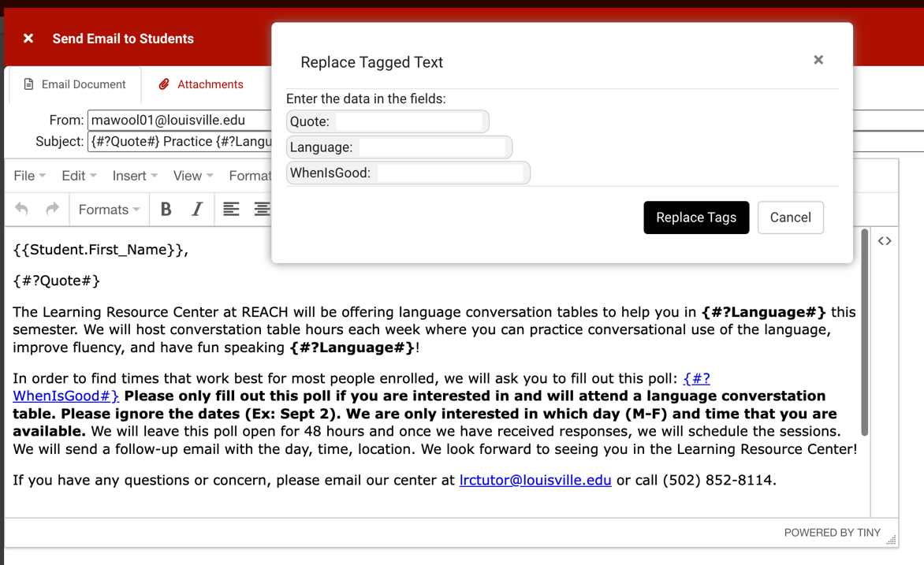
Examples
Email templates
Email templates allow you to configure pre-written emails that can be easily accessed and modified when needed. These could be used for standard messages that would be frequently sent to students.

Slide 30
REPORTs

Slide 31
Which reports have we found to be the most useful?
Reports
Consultant Max Hours and Non-Duplicated Appointment Time- New/Just Added
Consultant Non-Duplicated Visit Time
Payroll
Logins by day by hour of week
Appointments/availability by hour by day of week
Usage Snapshot*
Visits by Faculty/Subject

Slide 32
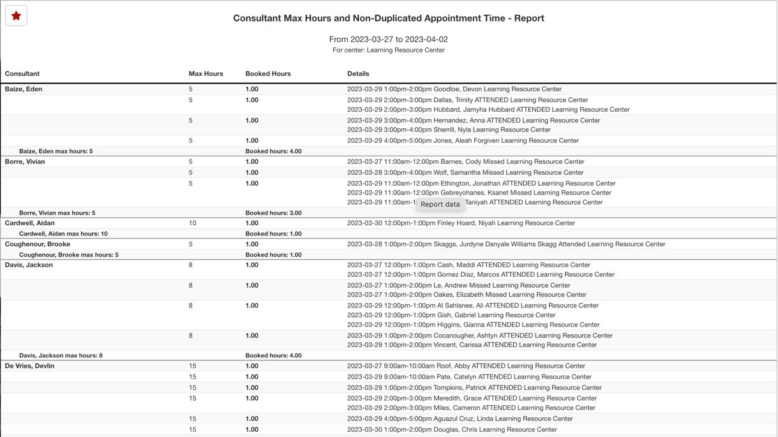
Consultant Max Hours and Non-Duplicated Appointment Time
We use the Max Hours field on the staff profile to put in the max number of hours a staff member wants to work. This report allows us to run quick report to see who is close to maxing out their hours. It works really good for someone who walks in and wants to make an appointment.

Slide 33
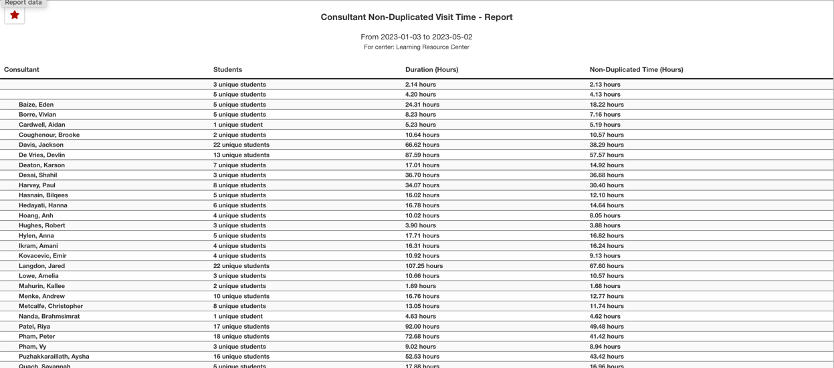
Consultant Non-Duplicated Visit Time
This report works great for reviewing tutor hours for CRLA Certification.

Slide 34
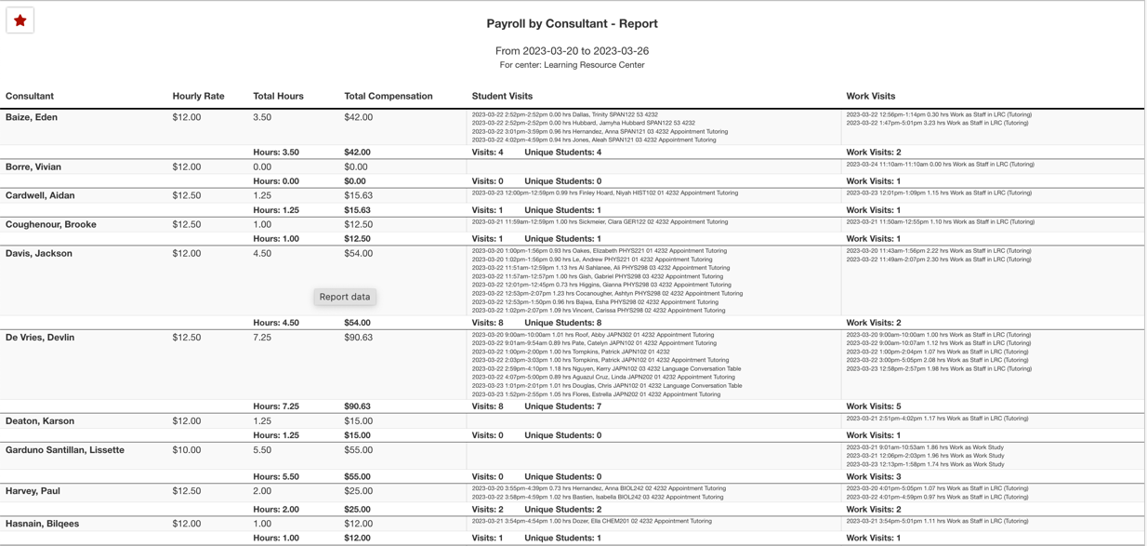
PAYROLL
Helps us with bi-weekly university time sheet submissions

Slide 35
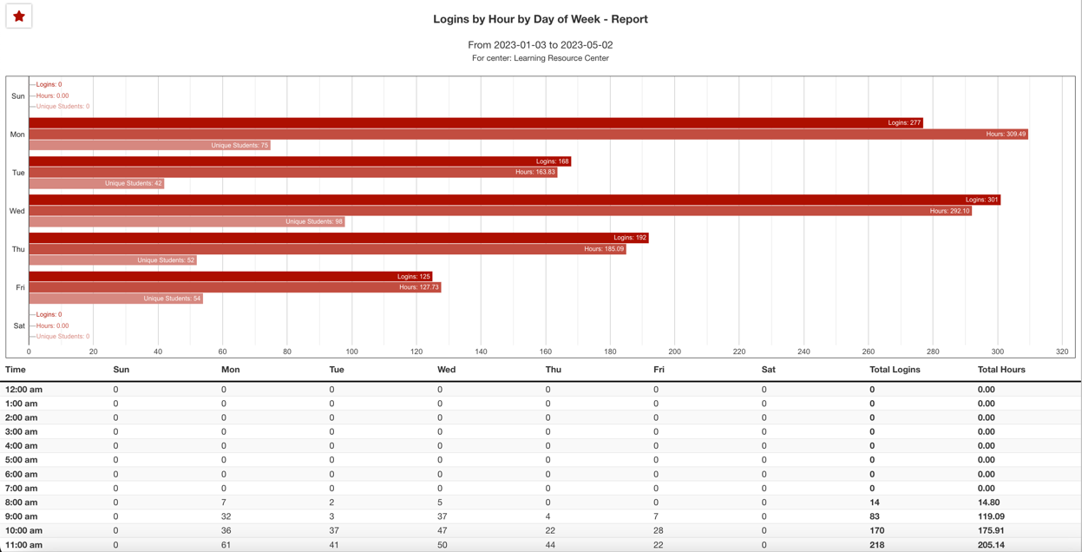
Logins by day by hour of week
We use this to help determine the best days/hours that tutors should offer appointments

Slide 36
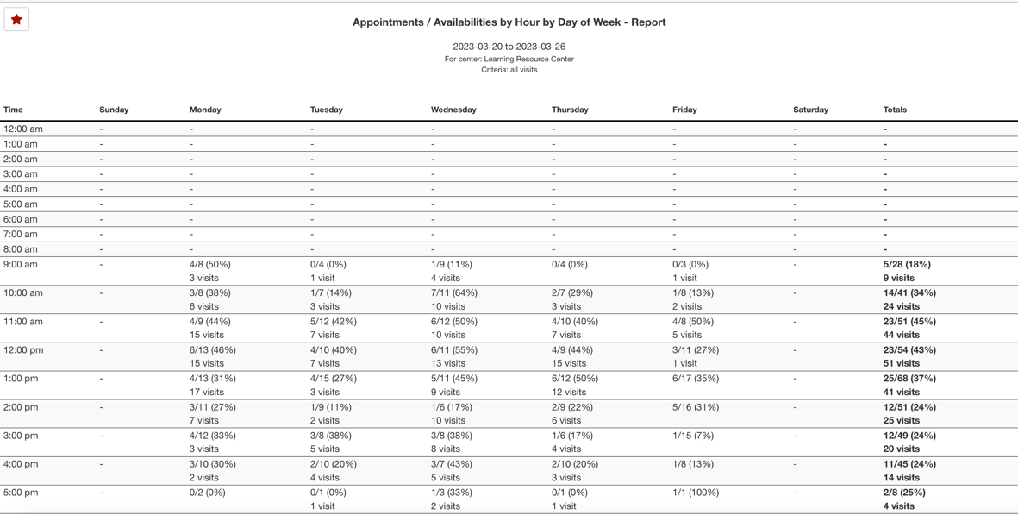
Appointments/availability by hour by day of week
We use this to help determine the best days/hours that tutors should offer appointments

Slide 37
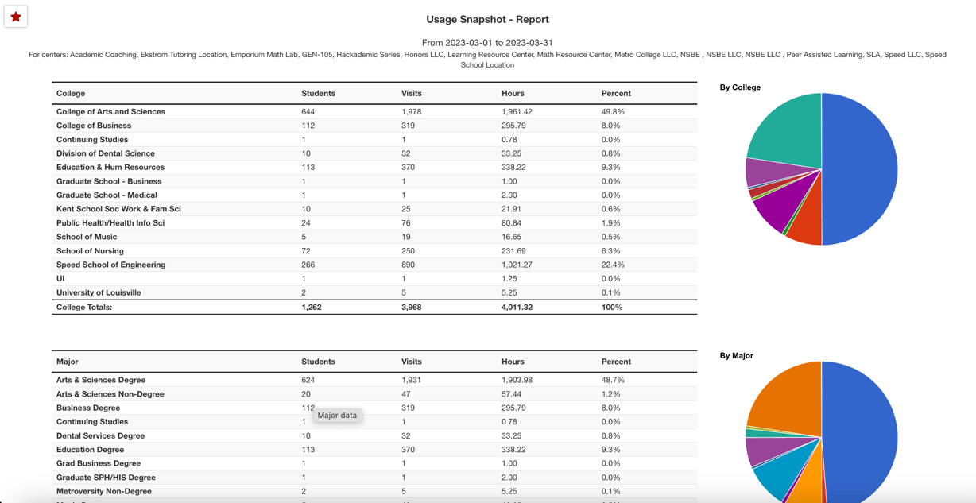
USAGE SNAPSHOT
Allows for quick access to data about the overall usage of all REACH services
Can be compared against other dates
One note about this report- date comparisons must be completed within the same semester

Slide 38
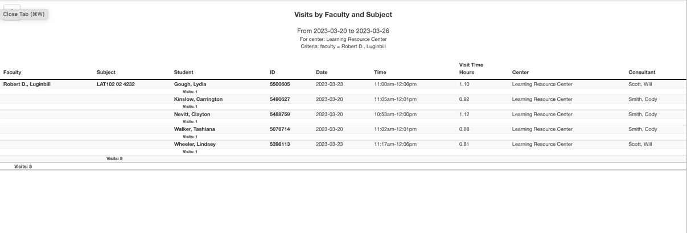
Visits by Faculty/Subject
Used for sending weekly/monthly reports to select faculty/staff about student visits

Slide 39
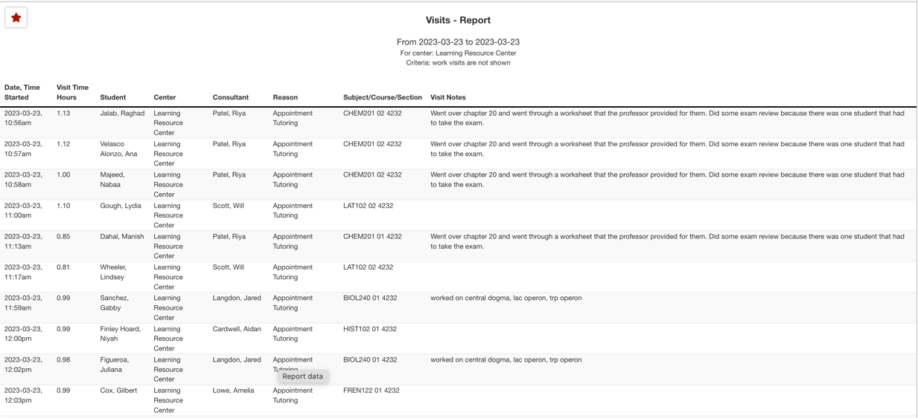
Visits bY??
Our go-to report for looking up information about the visit. We do include Visit Notes in most runs of this report

Slide 40
Questions?

