Slide 1
All You Need to Know About Visits
Iliana Visser

Slide 2
Why Should You Record Visits?
Student Visits allow you to record when your students met with consultants or dropped into your center. There are several options available for creating these visits, including real-time options like the Log Listing or Kiosk, used by staff and students respectively.
This session will be going over the different options such as Kiosk, Quick Visit, Batch Visit and how you can utilize them for your system.

Slide 3
Why Should You Record Visits?
-To capture meaningful data for detailed reports
-Track Center Usage
-Visit Data Can be Collected by:
Logging Students In and Out
Quick Visits
Batch Visits
SI Batch Visits
Kiosks
Custom Kiosk

Slide 4
What is a Kiosk?
Provides users with a Sign-In station that can run independently
Students sign in when they arrive and out when they leave
The Kiosk Station does not need to be staffed or actively overseen by a staff member
Since it is primarily used by students, access is very restricted

Slide 5
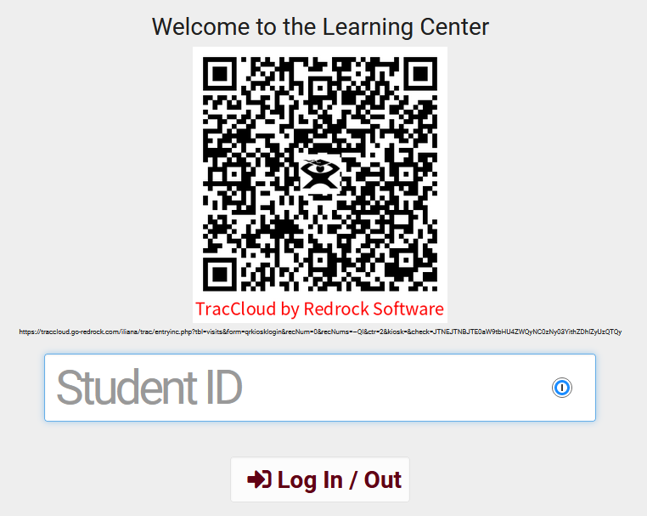
Kiosk
Allow student to sign in entering the student ID, using a barcode reader or scanning the QR code using the students mobile device.
Options are available to personalize the Welcome message and even the size of the QR code.

Slide 6
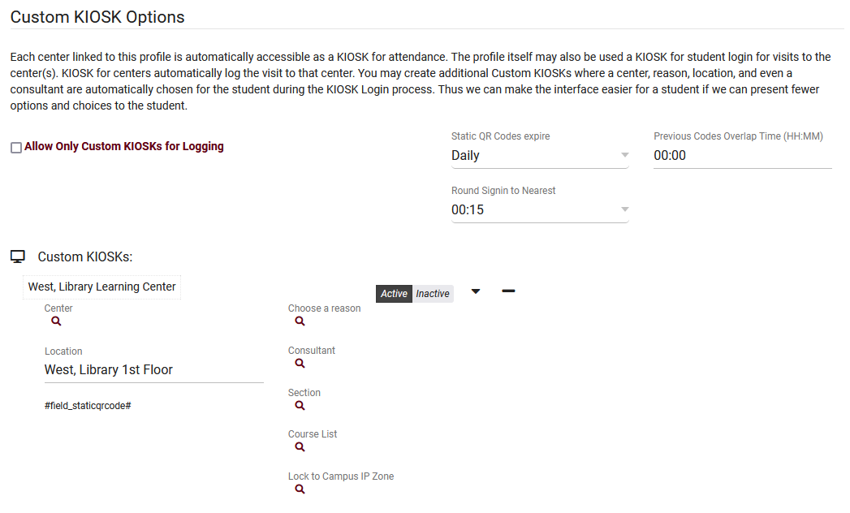
Custom Kiosk
Custom kiosks can be configured for specific visit scenarios. For example, if one of your kiosks is only going to be used for a specific Center/Location/Reason combination, you can use a Custom Kiosks to make sure students are logging in with those fields predetermined. You can also select a Consultant, Section, Course List and even IP address zone.

Slide 7
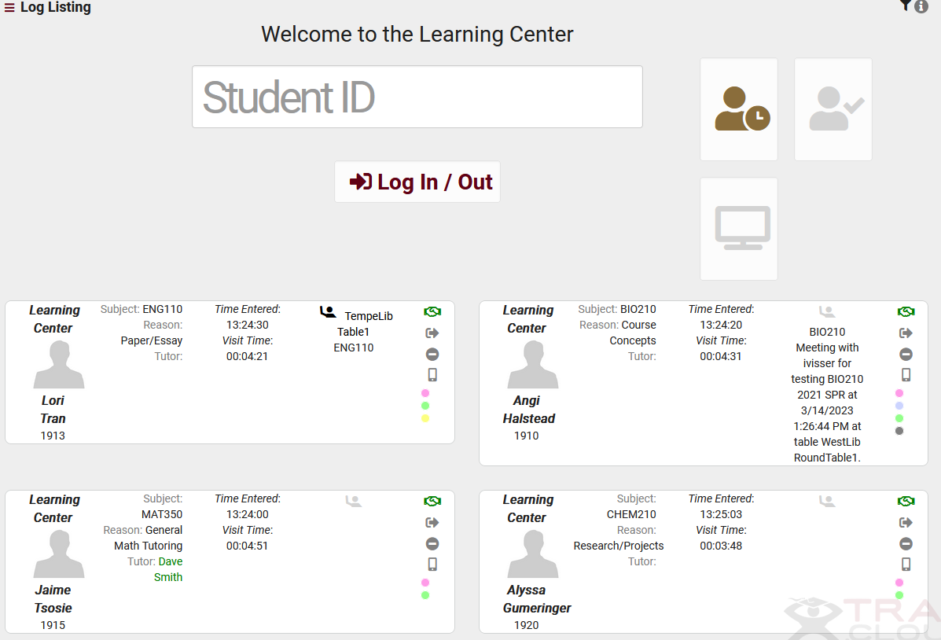
Log Listing
Log List Customization - These settings control how student data is displayed from the KIOSK and Log Listing views.
Show Consultant Login Button – allow the tutors to now sign into work by clicking on a designated Work button.

Slide 8
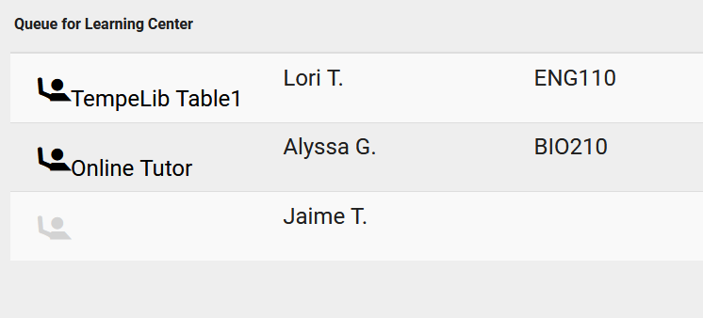
Queue List
A Queue List can now be accessed from a Kiosk or Log Listing page, allowing you to view students who are currently waiting to be seen. An example use-case is in a Center you would have screen such as a TV, Tablet or Projector that is student-facing and display where students are in line waiting to be seen.

Slide 9
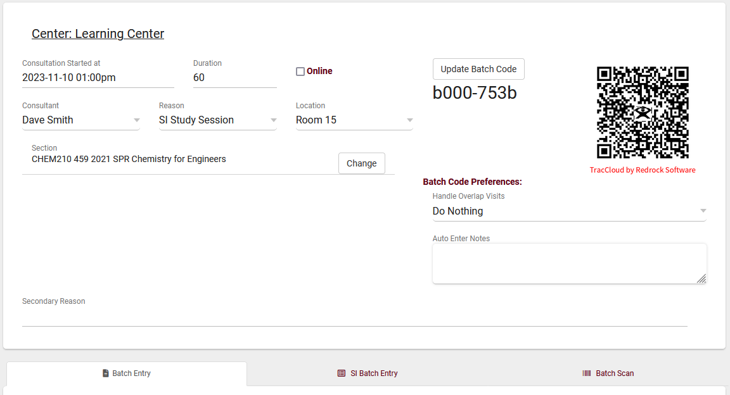
Batch Visits
Batch Visits can be thought of as a bulk version of Quick Visits, allowing you to create visits for many students at once. This feature can be found in Attendance > Batch Visits.

Slide 10
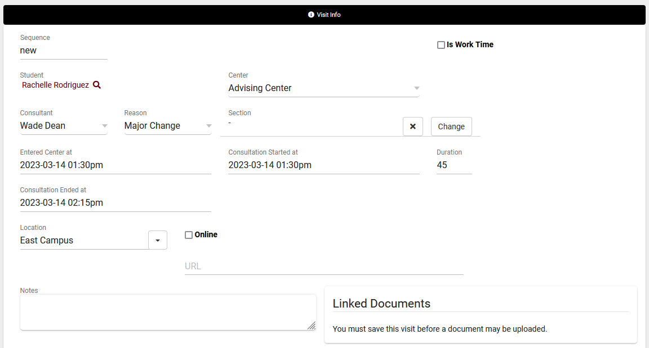
Quick Visits
Quick Visits allow you to create visits after the fact, maybe a student forgot to login, or a login station wasn’t available at the time, or even if you wanted to record a phone call or email conversation.

Slide 11
Attendance Listing
A Visit represents the log that the student was present at your center at X time, for Y subject, Z reason, etc. This is different from an Appointment, which is represents the reservation. If a student doesn't follow through with an Appointment, a Visit is never created. Every Visit in the Trac System can be viewed in this listing.

